Slide 1
Cluster Representation
Wendy Rawson
Library Director
Fitchburg Public Library

Slide 2
Why clusters?
The cluster format was designed to provide representation for each library. They have been formed geographically since 2012.
Prior to clusters, all libraries were expected to attend frequent meetings (LINK and county) to make policy decisions. Clusters alleviated that burden.
Clusters are formed geographically for ease of meeting and shared experiences.

Slide 3
Cluster map

Slide 4
Cluster representatives form the following committees:
Administrative Council
ILS
Technology
Delivery

Slide 5
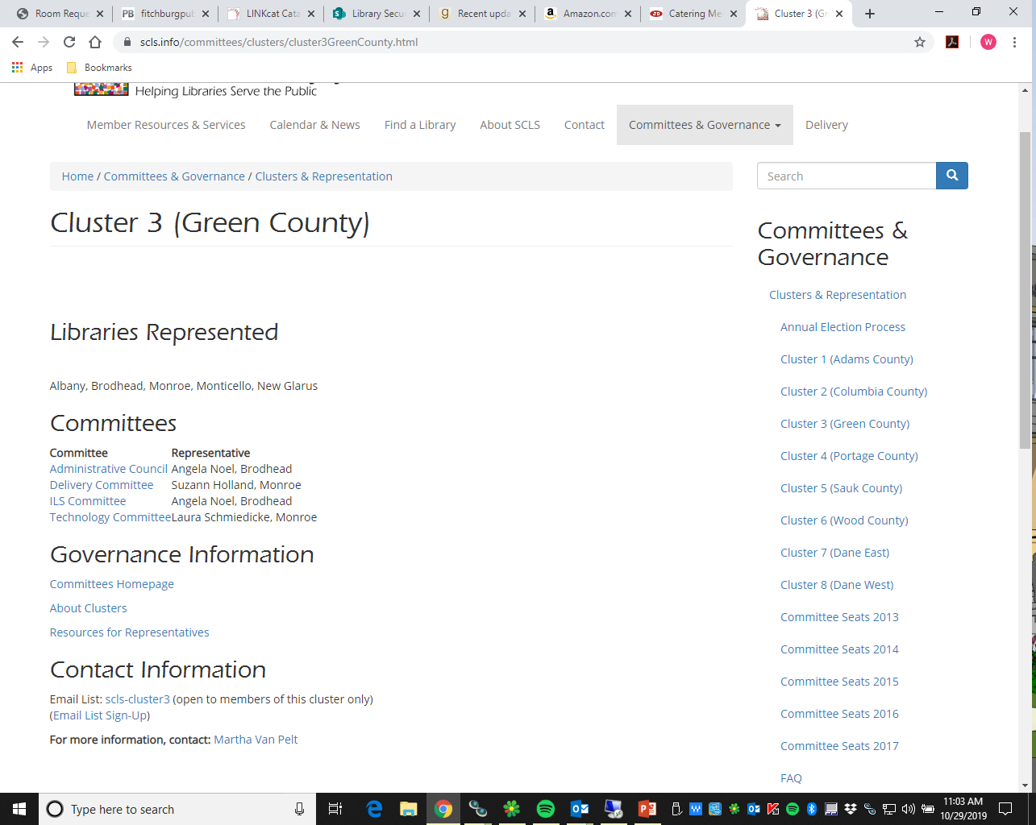
Who are my cluster reps?

Slide 6
How do you become a cluster rep?
Library directors or their designees are eligible for the AC.
All staff are eligible for ILS, Technology and Delivery.
Elections are held for every cluster rep seat. Elections are staggered to minimize turnover.
Terms are two years.
Each library in a cluster has one vote in each election.
Call for nominations comes out in September to fill empty seats. Must have permission to nominate another person; self nomination is also allowed.
Voting happens in October. Ties are subject to a second vote. A second tie is decided by a coin toss.
New reps start in January.

Slide 7
Your responsibilities as a cluster rep
Attend all committee meetings (in person, via phone or videoconference) or arrange for a proxy. Prepare for meetings by reading material provided in advance.
Prior to each meeting, share the draft agendas with your cluster and ask for items for initial discussion.
After each meeting, share back any important decisions that were made or topics that were introduced. Solicit feedback as needed.
Each cluster should meet quarterly. These meetings can be combined with other meetings (example: Dane County Directors meeting doubles as Cluster 7 & 8 meetings)

Slide 8
Your responsibilities as a cluster member
Reach out to your appropriate cluster rep with any issues or concerns that you may have.
Share topics for discussion that you’d like your rep to take to a meeting on your behalf.
Read the emails that your reps send to you and provide feedback in an appropriate time frame.
For more detail, review committee meeting minutes.
Thank the people who are spending their time attending meetings on behalf of your library!

Slide 9
Communication is everyone’s responsibility!

