Slide 1
Welcome to the SCLS May 2021 All Directors Meeting!

Slide 2
2022 Administration and Consulting Services Revenue
SUBPROGRAM/ ITEM/ACCOUNT CODE | 2021 MID YEAR BUDGET | 2022 BUDGET | CHANGE FROM 2021 MID YEAR
STATE AIDS - 4010 | $2,199,966.00 | $2,199,966.00 | $0.00
INTEREST INCOME – 4030/4040 | $20,000.00 | $5,000.00 | -$15,000.00
INTEREST/DIVIDENDS FIXED INC PORTFOLIO- 4041 | $42,329.00 | $39,480.00 | -$2,849.00
INTEREST/DIVIDENDS CD ACCOUNT- 4042 | $0.00 | $0.00 | $0.00
WLA RENT - 4220 | $22,997.75 | $23,607.65 | $609.90
CONSULTING SERVICES FEES- 4280 | $0.00 | $0.00 | $0.00
FOUNDATION ADMIN FEES- 4290 | $30,000.00 | $30,000.00 | $0.00
TOTAL REVENUE | $2,315,292.70 | $2,298,053.60 | -$17,239.10

Slide 3
Administration and Consulting Services Revenue
Administration and Consulting Services revenue is projected to decrease in 2022, with the most significant decreases coming in the form of projected interest income. WLA Rent is still anticipated to increase, based on our contractual agreement.
Interest Income: -$17,849.00
WLA Rent: $609.90
Total decrease in revenue projected for 2022: $17,239.10
These funds will be recouped through reductions in expenses.

Slide 4
2022 Administration Expenses
SUBPROGRAM/ ITEM/ACCOUNT CODE | 2021 MID YEAR BUDGET | 2022 BUDGET | CHANGE FROM 2021 MID YEAR
OUT-OF-SYSTEM INTERLOAN - 5310 | $28,490.15 | $29,038.96 | $548.81
ONLINE CONTENT AND MEMBERSHIPS - 5320 | $45,058.00 | $45,053.14 | -$4.86
STAFF SALARIES AND WAGES - 7610 | $248,010.00 | $254,923.58 | $6,913.58
FACILITY - HQ - 7650 | $240,353.17 | $237,066.11 | -$3,287.06
SUPPLIES - 7655 | $2,000.00 | $2,000.00 | $0.00
TELEPHONE - 7670 | $13,845.00 | $14,975.00 | $1,130.00
POSTAGE - 7680 | $1,000.00 | $800.00 | -$200.00
BOARD TRAVEL & EXPENSES & MEMBERSHIPS - 7690 | $1,000.00 | $3,000.00 | $2,000.00
EMPLOYEE INSURANCES ADMIN AND CONSULTING- 7700
7701 Health Insurance | $135,080.00 | $141,752.00 | $6,672.00
7702 Income Continuation Insurance | $0.00 | $0.00 | $0.00
7703 Dental Insurance | $10,438.00 | $10,753.00 | $315.00
7704 Life Insurance | $6,035.00 | $6,713.00 | $678.00
WISCONSIN RETIREMENT - 7710 | $50,200.00 | $50,666.00 | $466.00
SOCIAL SECURITY/MEDICARE (FICA) - 7720 | $56,893.00 | $57,422.00 | $529.00
WORKERS COMP AND GENERAL INS - 7730 | $12,147.00 | $13,990.00 | $1,843.00
UNEMPLOYMENT - 7735 | $500.00 | $1,000.00 | $500.00
AUDIT - 7740 | $19,000.00 | $19,000.00 | $0.00
CONTRACTED SERVICES HQ - 7745 | $19,897.00 | $21,097.00 | $1,200.00
BOOKKEEPING - 7750 | $9,000.00 | $9,000.00 | $0.00
FLEXIBLE SPENDING ACCOUNT (FSA) FEES - 7751 | $1,400.00 | $1,400.00 | $0.00
SCLS COMPUTER HARDWARE AND SUPPLIES - 7752 | $21,500.00 | $13,500.00 | -$8,000.00
SCLS OFFICE EQUIPMENT AND REPAIRS - 7760 | $1,000.00 | $1,000.00 | $0.00
FIRST BUS BANK FIXED INCOME FEES - 7771 | $9,800.00 | $9,800.00 | $0.00
DELIVERY/GENERAL CARRYOVER - 8010 |  |  | $0.00
BANK SERVICE FEES - 8011 | $700.00 | $700.00 | $0.00
LEGAL FEES-8015 | $1,000.00 | $1,000.00 | $0.00
TOTAL ADMINISTRATION EXPENSES | $934,346.32 | $945,649.79 | $11,303.47

Slide 5
2022 Consulting Expenses

Slide 6
Administration and Consulting Services Expenses
Administrative expenses are increasing primarily in the areas of wages, telephone, board travel and insurances. The wage increase is due to hiring an in-house custodian in lieu of an outside janitorial company. Telephone expense changes are due to replacing HQ landlines with cell phones for improved communications with staff while working remotely. It is planned for the board to resume in-person meetings in 2022. All lines of insurances are projecting cost increases. These increases will be offset by a reduction in facility costs and computer replacement costs.
Consulting expenses overall have been reduced to offset the loss of revenue and the increases in insurances and administrative expenses. The only projected increases are in the areas of salaries, due to step increases and staff mileage as we return to in-person library visits in 2022.
There are no wage grid or COL increases factored in to any 2022 budgets.
Administration Expenses:
Increase of $11,303.00
Consulting Services:
Decrease in expenses of $28,542.00
Total
Decrease in overall expenses of $17,239.00

Slide 7
General Carryover Fund
Planned use of General/Delivery Carryover funds in 2021:
1 Delivery Van and 1 Delivery Truck ($86,000)
Delivery Carts ($5,680)
This will leave the General/Delivery fund at a beginning 2022 balance of approximately $797,916. Per the SCLS Carryover Policy:
A portion of the general fund must be maintained to cover outstanding liabilities.
The remainder may be allocated to fund projects, purchase materials/equipment, finance system/county consolidation efforts or any other use deemed appropriate by SCLS or the Board of Trustees to be of member or system benefit.
Future considerations for use of the General/Delivery Carryover fund into 2022 will include the SCLS building project. Up to $500,000 has been approved.

Slide 8
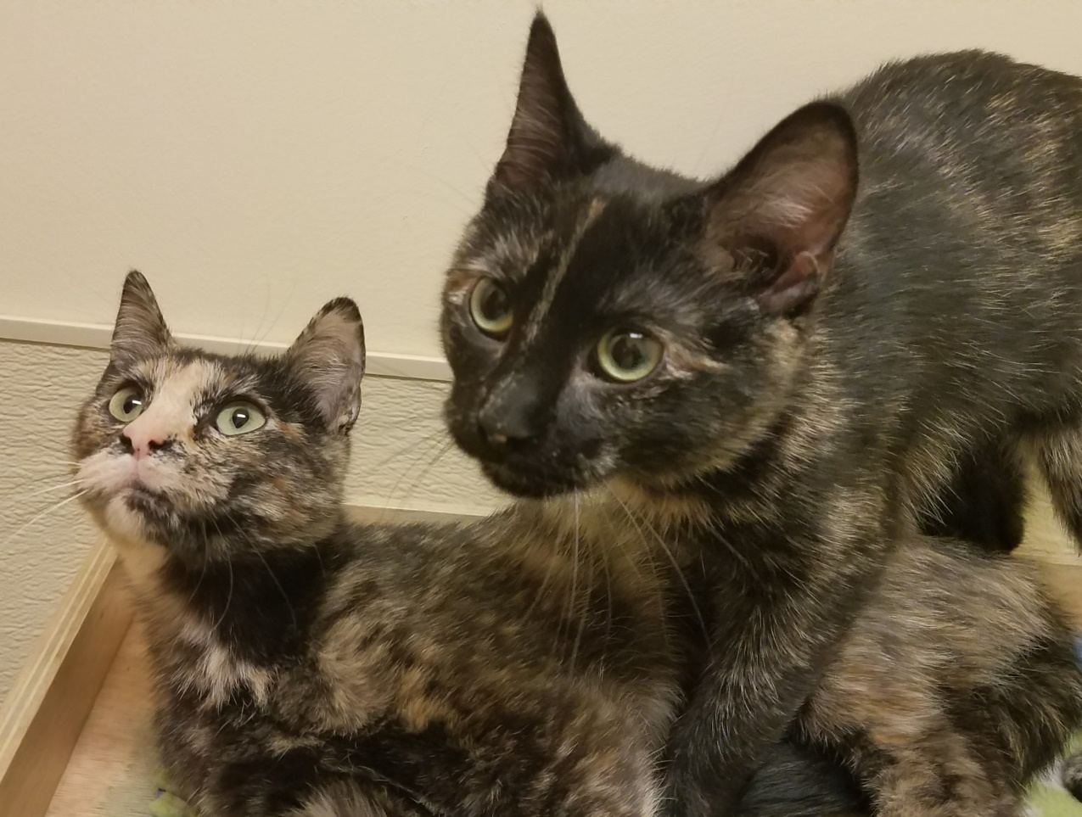
Questions?

