Slide 1
SCLS Consultant Team
Mark Ibach
Consulting Services Coordinator
May 27, 2021

Slide 2
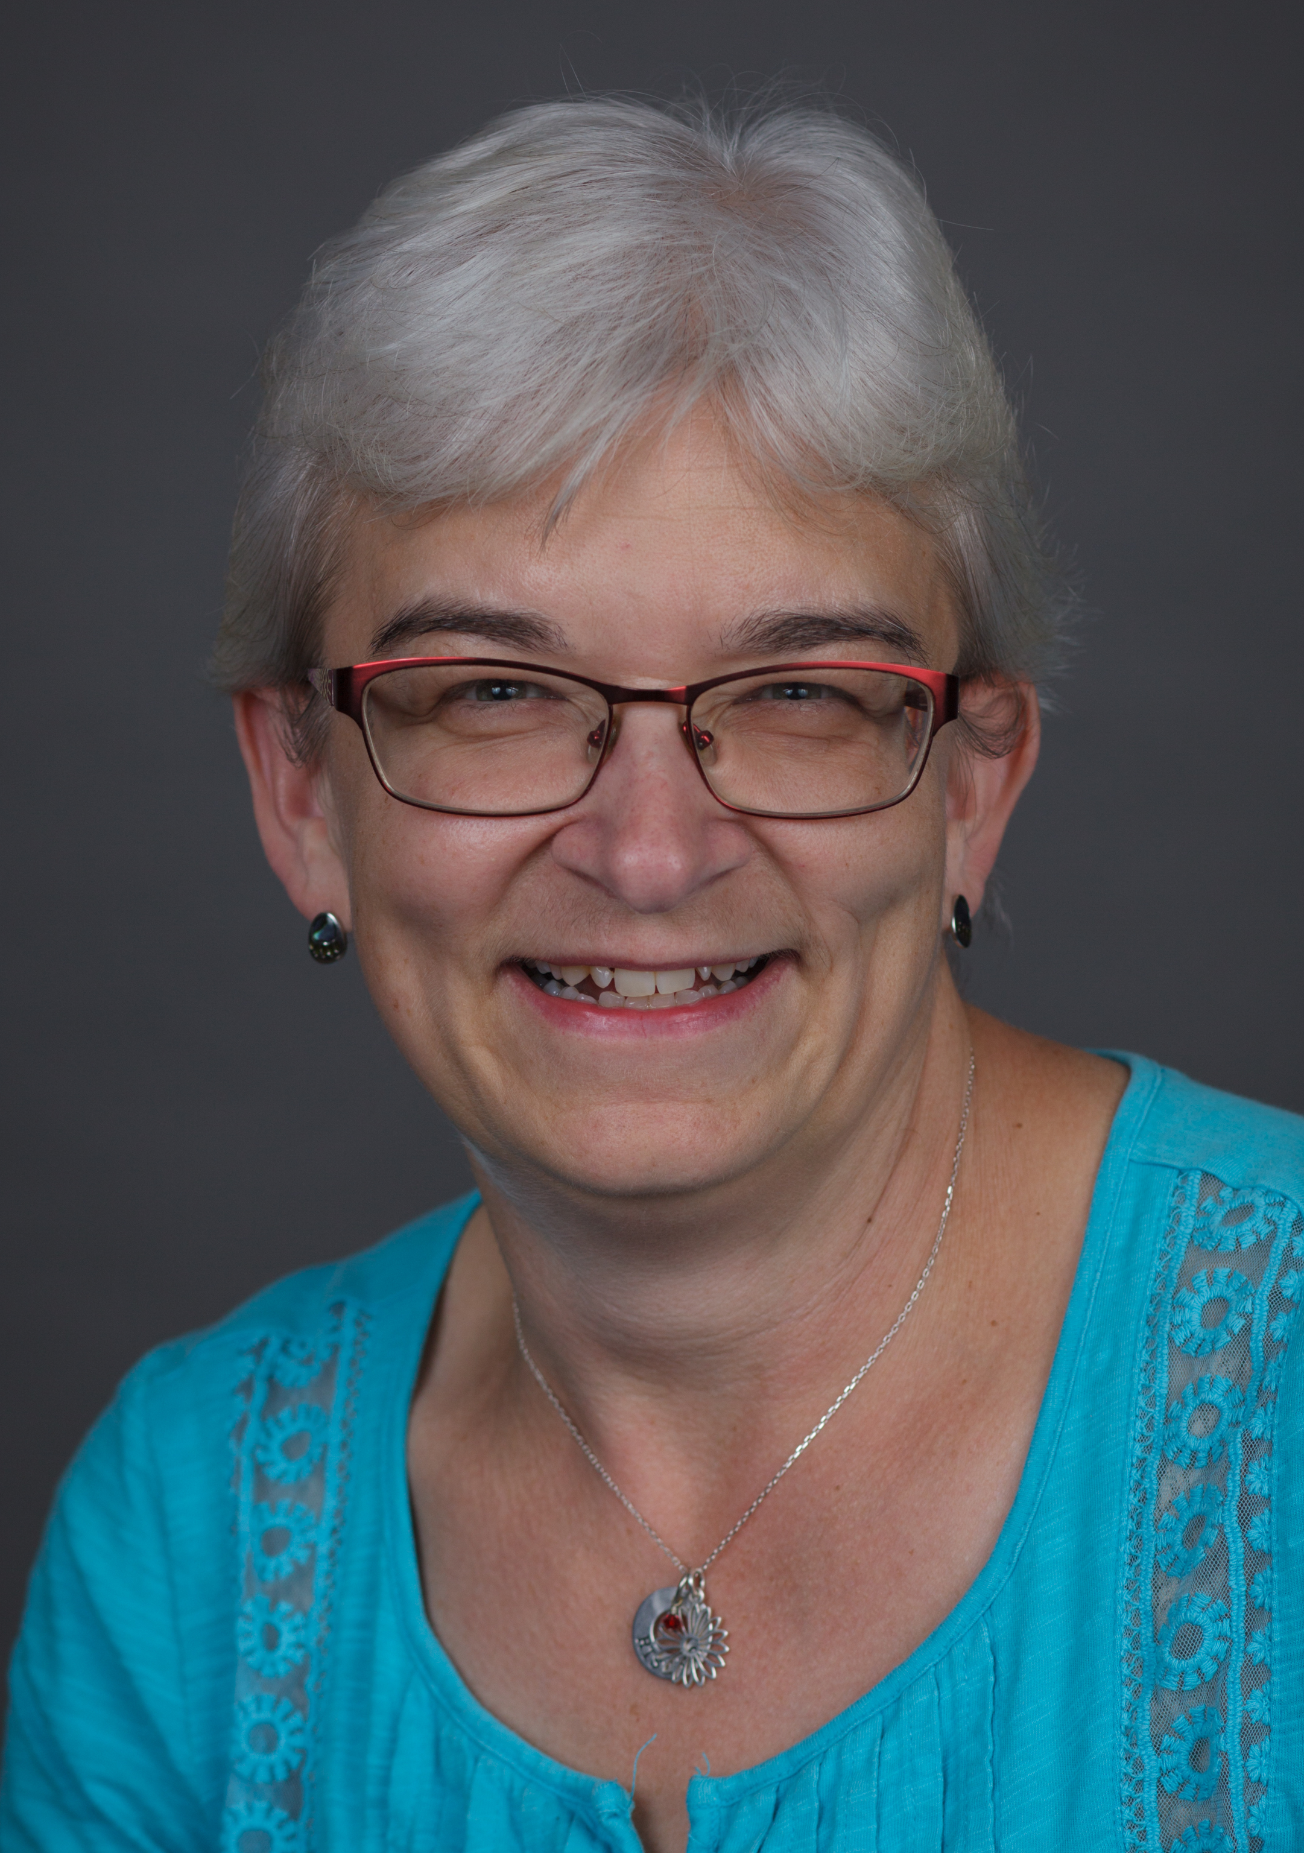
Jean Anderson Continuing Education Consultant
Joined SCLS in February 2007
Plans & implements continuing education programs
Involved in regional and statewide continuing education projects
Conducts OverDrive Short Courses
Maintains SCLS Professional Collection

Slide 3
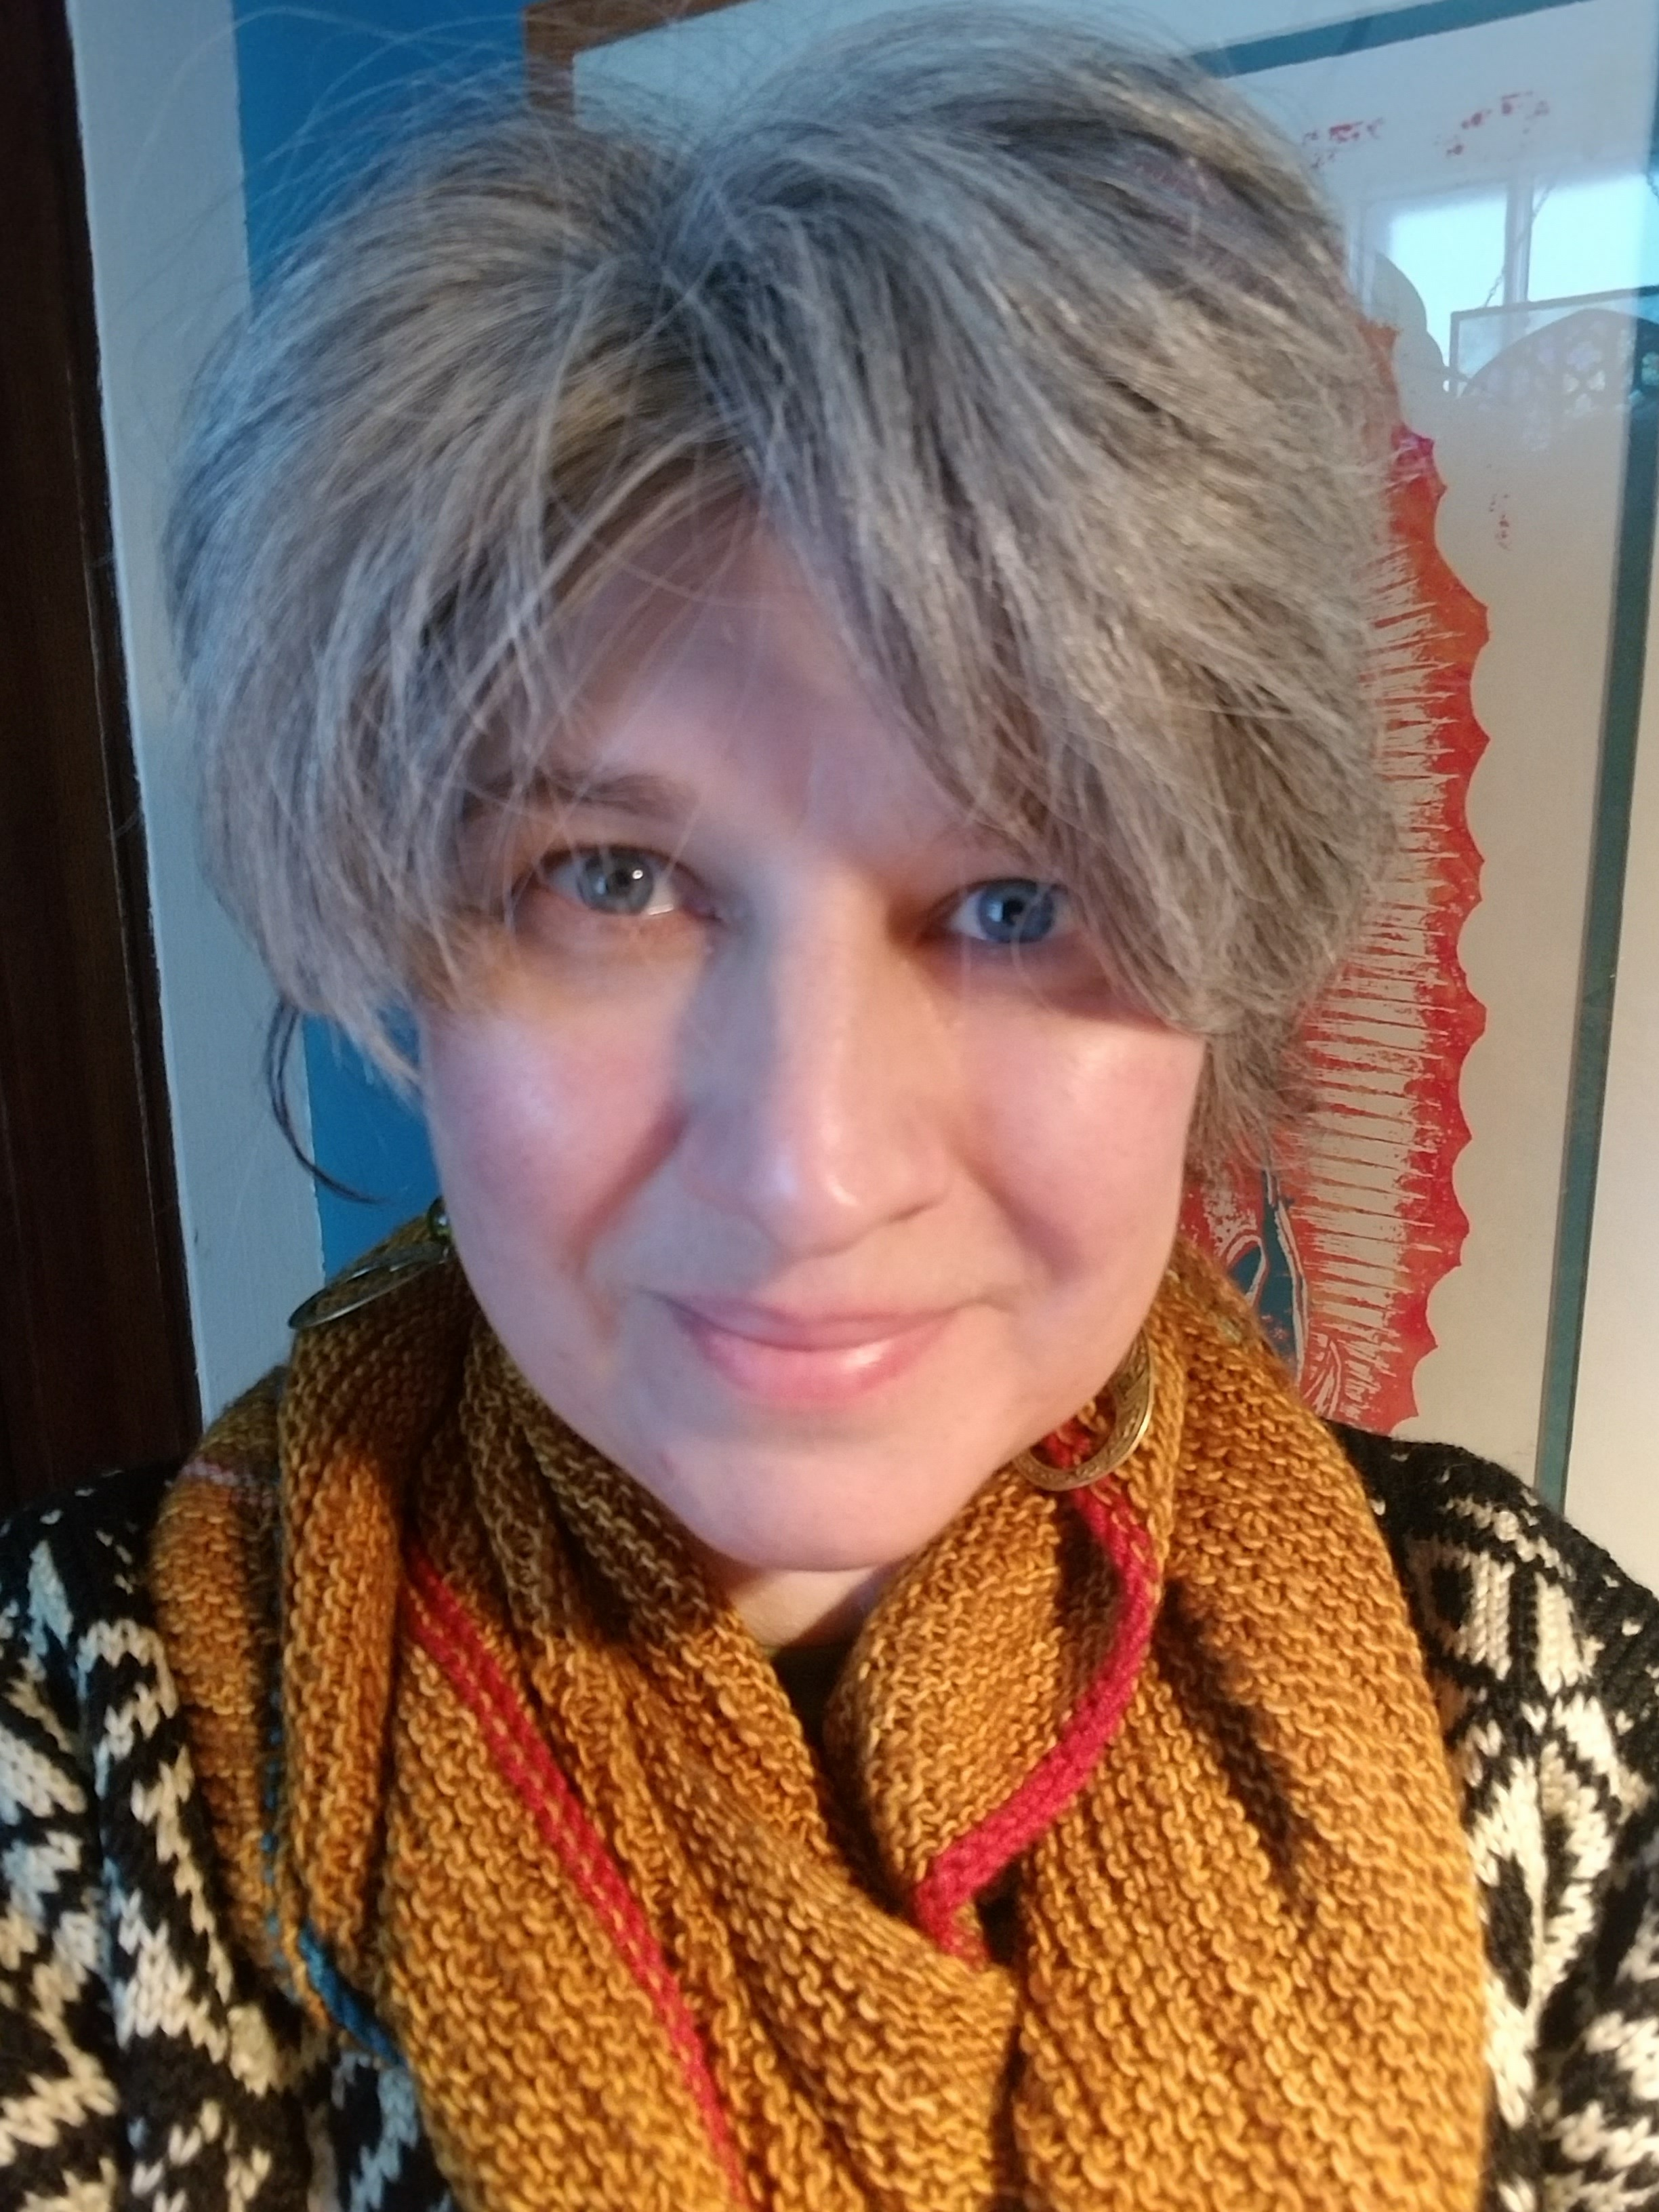
Shawn Brommer Youth Services & Community Engagement Consultant
Joined SCLS in April 2001
Consults on youth services and community engagement
Leads SCLS strategic planning services
Provides oversight to implement inclusive services.

Slide 4
Deb Haeffner Building & Design Consultant
Joined SCLS in February 1983
Provides graphic design services
Works with library staff and trustees to design new and remodeled library spaces
Helps libraries identify furniture and carpeting options and find best pricing

Slide 5
Jody Hoesly Data Services Consultant
Joined SCLS in February 2017
Develops and maintains data dashboards for SCLS and member libraries.
Provides leadership for SCLS database authentication efforts
Provides visuals for library strategic plans
Instrumental in preparing annual report data

Slide 6
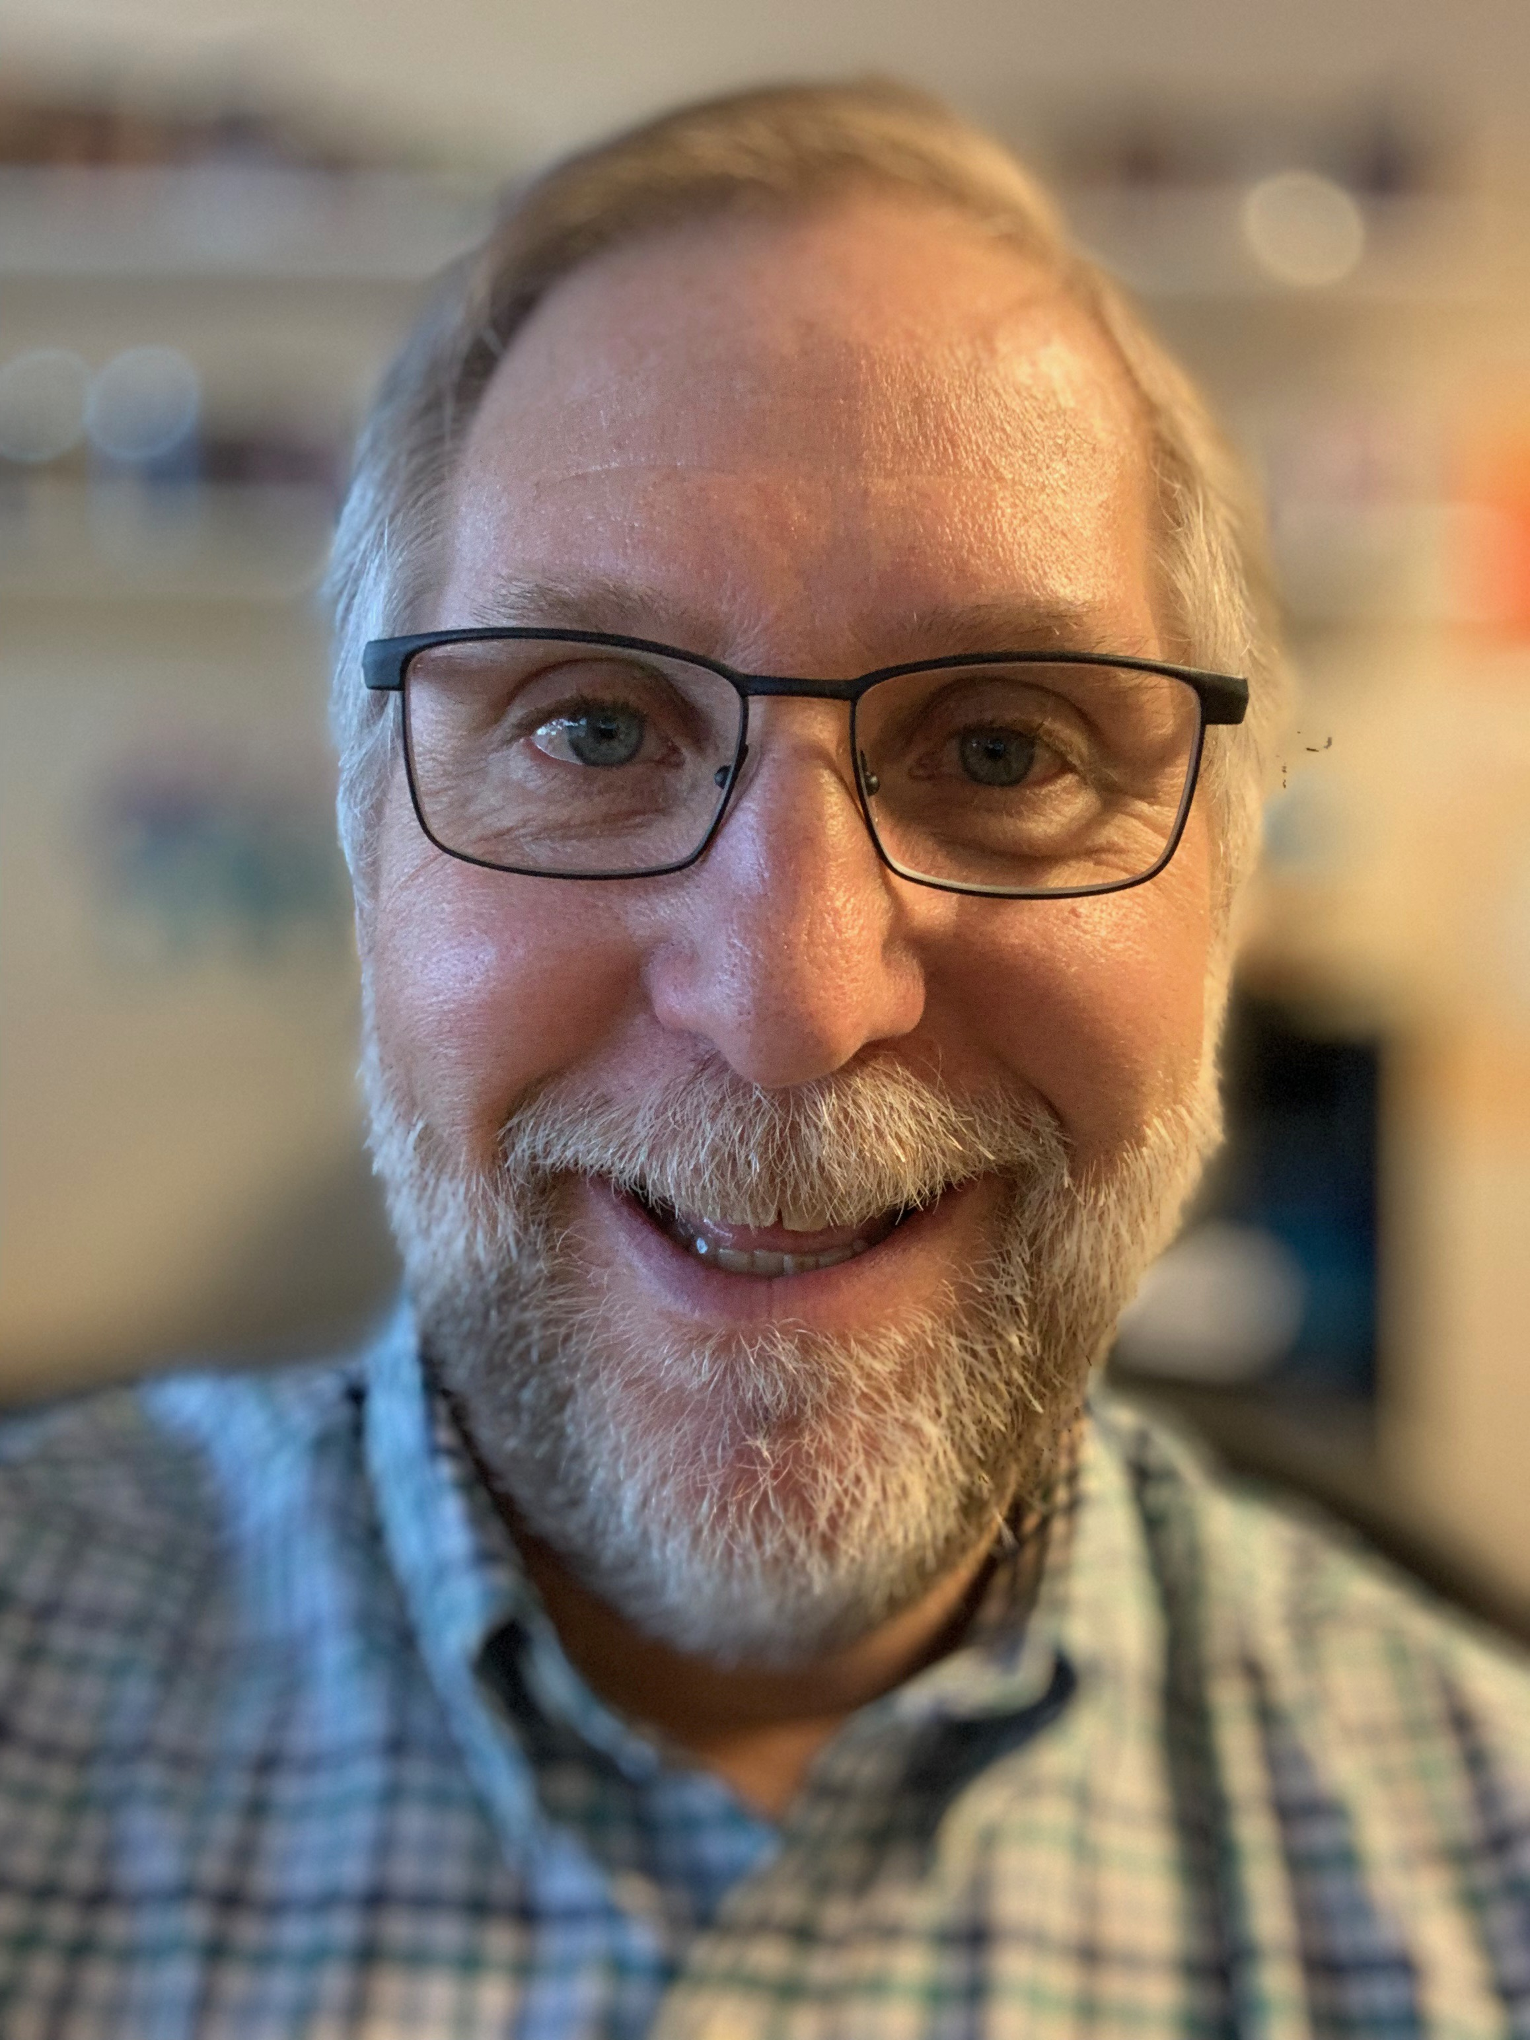
Mark Ibach Consulting Services Coordinator
Joined SCLS in January 2004
Supervises SCLS Consultant Team and helps manage the budget
Manages the annual report and adjacent county processes and provides support to libraries
Calculates county tax exemption levels
Answers legal and procedural questions

Slide 7
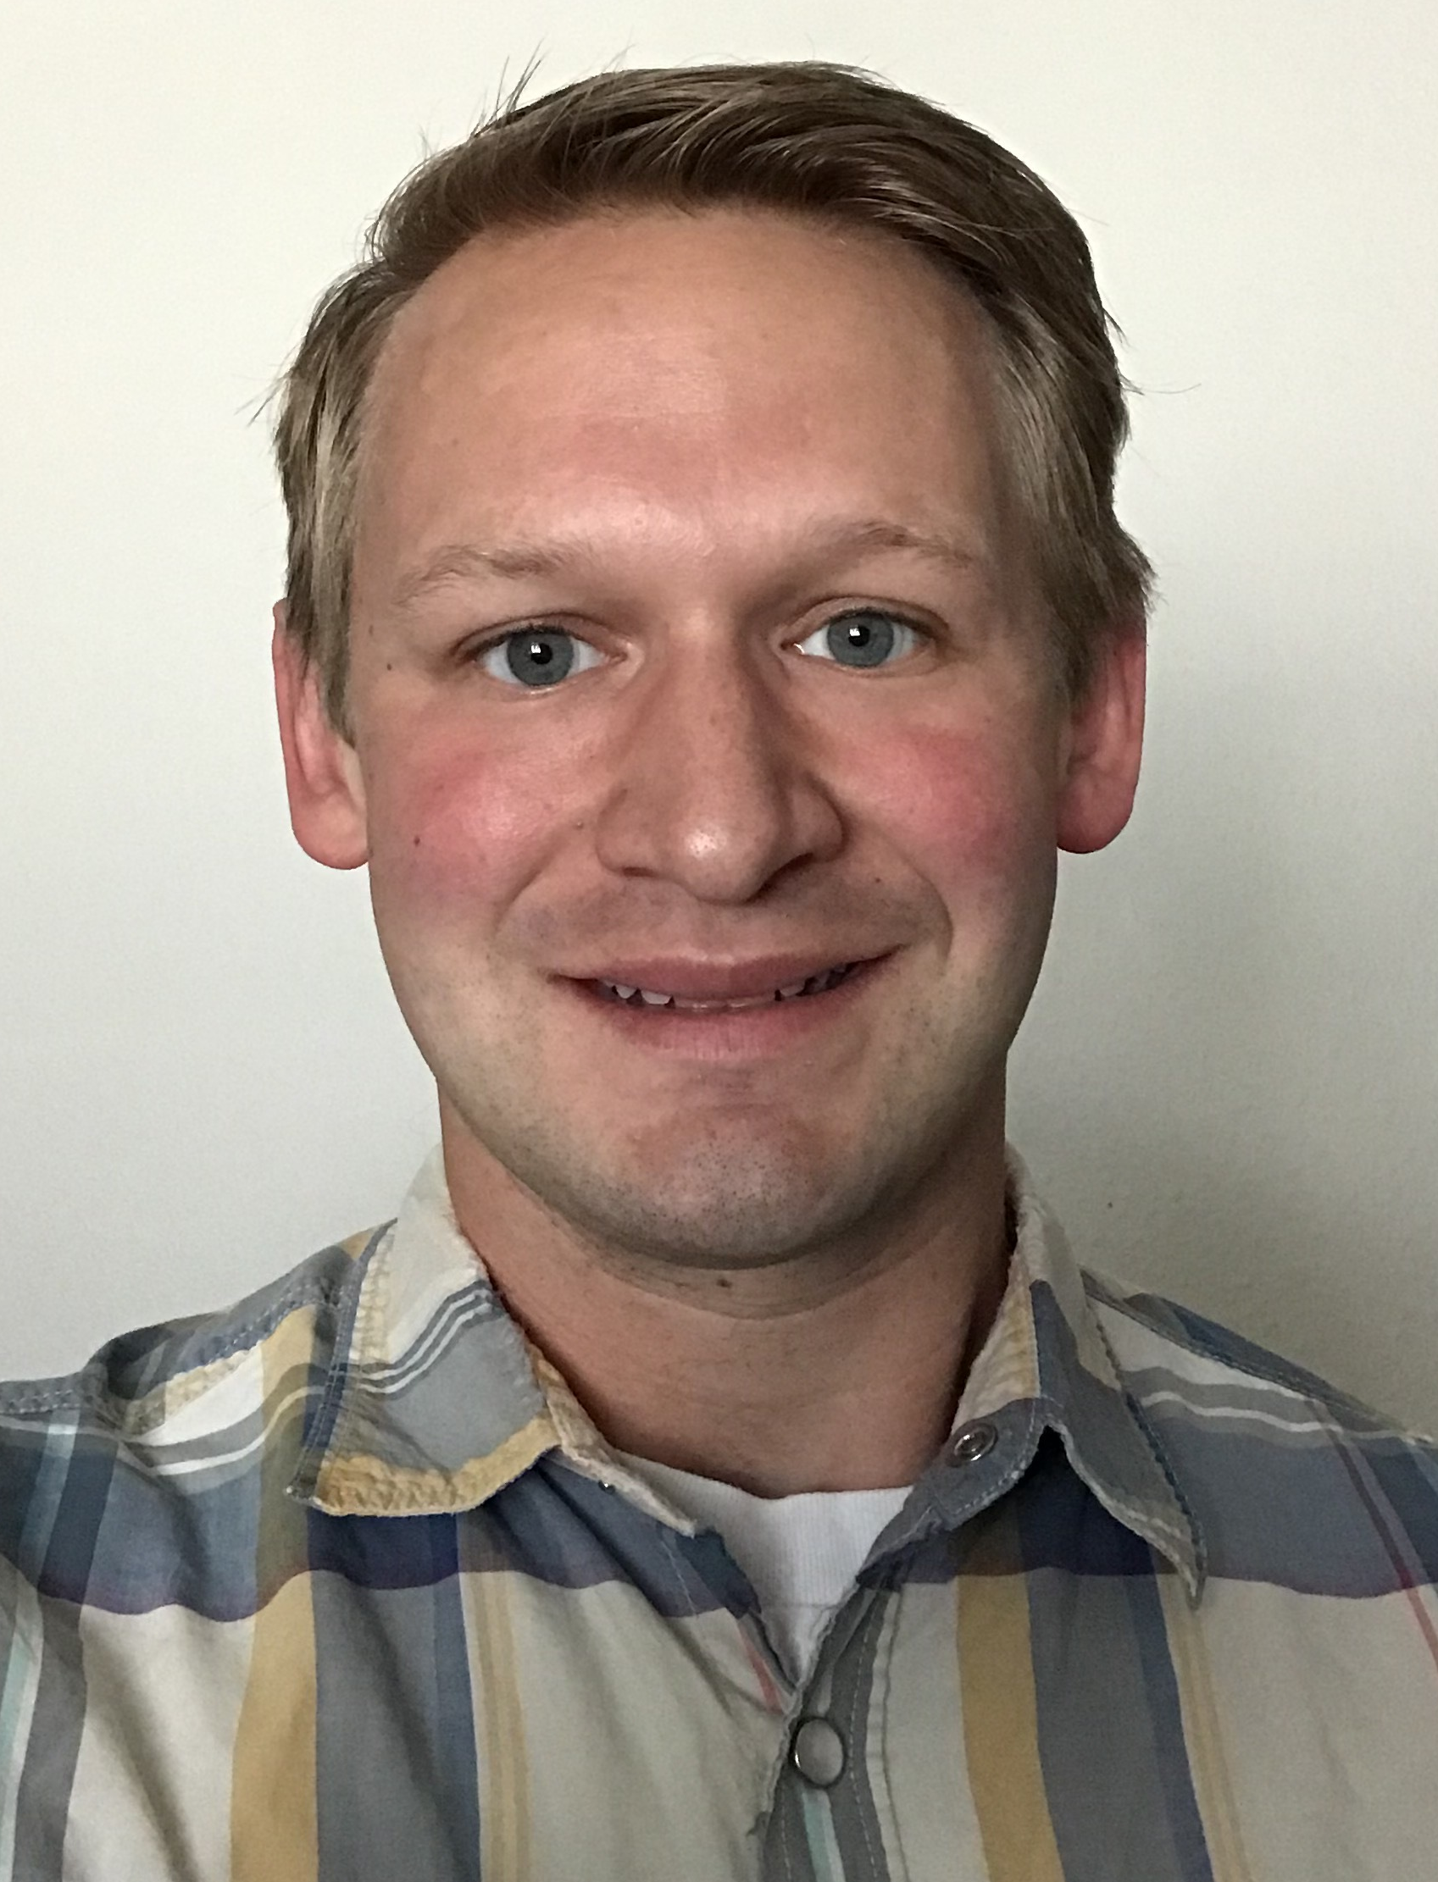
Mark Jochem Workforce Development Specialist
Joined SCLS in April 2018
Helps libraries with local workforce development needs
Connects library staff and residents with community partners
Also weaves in related issues like poverty, food insecurity housing, family support & transportation
Helps identify local inclusive services needs

Slide 8
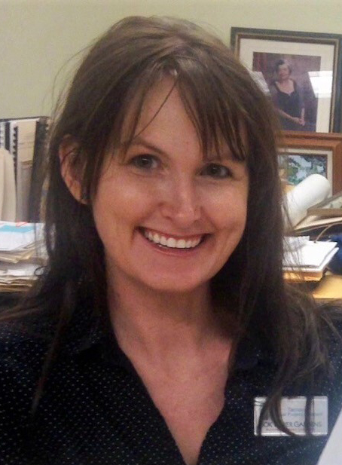
Tamara Ramski Digitization Specialist
Joined SCLS in January 2018
Assists libraries with all aspects local historical digitization projects
Develops training materials
Ensures copyright compliance
Uploads digitized materials to CONTENTdm
Develops and supports digitization kits

Slide 9
Rose Ziech Web Services Consultant
Joined SCLS in March 2008
Oversees general website management for SCLS and member libraries
Works with website vendor to ensure that updates and security fixes are implemented
Advises SCLS staff about technology trends that leverage the power of websites

