Slide 1
SCLS Delivery – Budget Prep Update
Board of trustees
5/27/21

Slide 2
2022 Budget Prep
Current Service Update
PLSR- Public Library System Redesign Recap
SCLS as Statewide Delivery Coordinator
UW Delivery Contract 2021 and beyond
State Aid
Cost Considerations (at SCLS Delivery)
Fees for 2022

Slide 3
Current Service Update
Quarantine eliminated
Volume
  83% of pre-pandemic
Frequency
  Nearly all of the pre-pandemic M-F stops are restored
  Some modification
History
  Saturdays to save on PT hours
    Approx 1/3 of PT hours were eliminated to make the 2021 budget
    Not planning to restore: $25,000 minimum

Slide 4
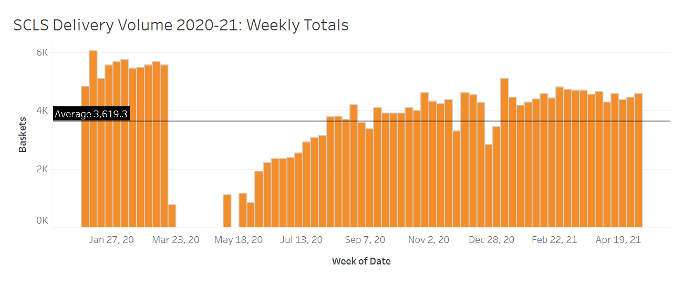
Volume Grid

Slide 5
PLSR Recap
Workgroup for Delivery began 2015
Report completed 2019 Steering Committee
  Hub Model was conceptualized
Pandemic delay in implementation
  Bruce Smith- project coordinator
Implementation of Hub model to phase in completely by Jan. 2025
Hub Model MAP:

Slide 6
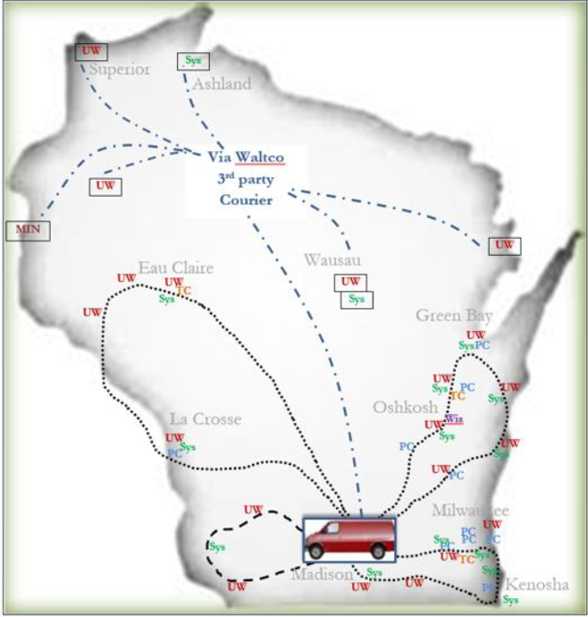

Slide 7
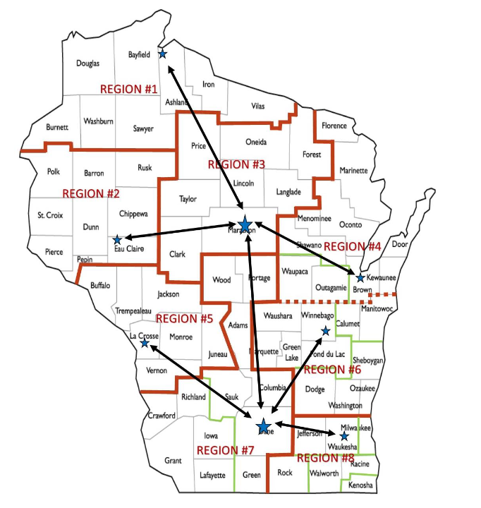

Slide 8
UW Delivery Contract
Significant share of revenue for SCLS
2021
2022 and 2023
  SCLS will return to 5-day service while cutting a percentage of the revenue from UW $133,308 (15%)
  Staffing to remain the same: pressure to keep all routes staffed especially during vacations/absences; scheduling managers regularly on routes (they only sub now)
  Sorting
2024 and beyond –
  3 hubs to finish the last mile. Resources shared with local delivery models to complete the “last mile”

Slide 9
State Aid Increase?
We have proposed figures from the Governor’s budget

Slide 10
Cost Considerations
With less revenue via the UW System, more emphasis on our local fees and costs
Vehicle purchases have been out of the budget for over 5 years (at least in part)
  This was an effort to minimize fee increases on the SCLS side
COL increase did not occur in 2021 (and not planning for 2022)
Lease at Delivery facility is 1%
Insurance

Slide 11
Fees for 2022
3% in order to return to pattern
  This would net approximately $12,000 if applied to existing ratios
  Corey will chart out several options
Scaling/Implementing a balanced fee structure that is matched against not just route costs, but material volume
  Conceptual. Gradual implementation
  Some fees up / some down
  Delivery Committee agenda for June

Slide 12
To be determined:
State Aid
  One option to address fees?
UW final approval
SCLS Hub connections beyond 2023
Marathon County 2023
  Another option to address fees?

