Slide 1
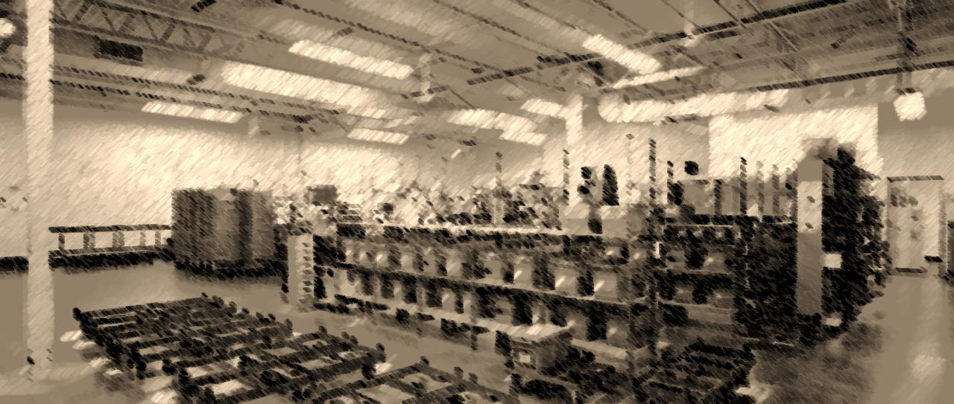
SCLS Delivery
November 19, 2021

Slide 2
Who are we?

Slide 3
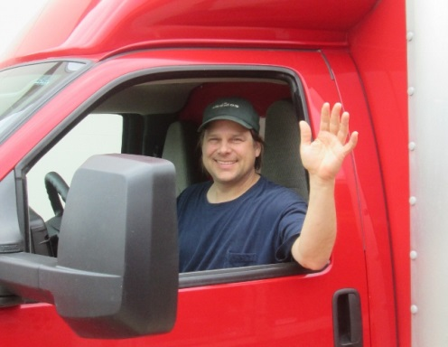
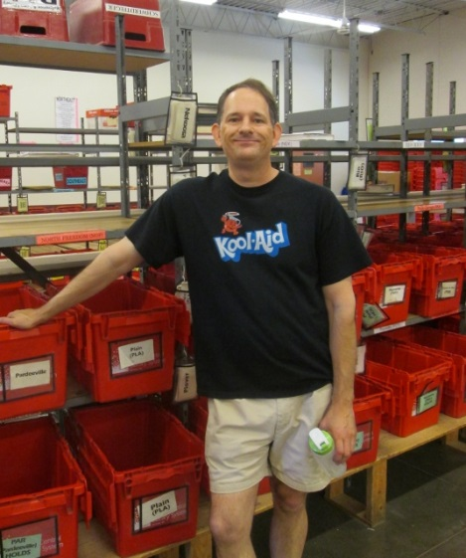
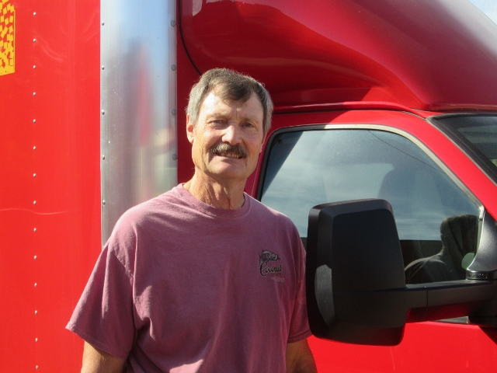
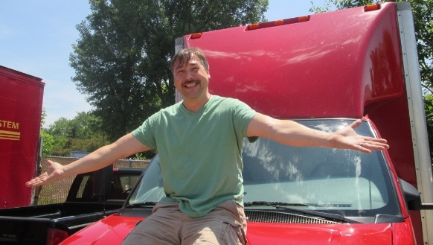
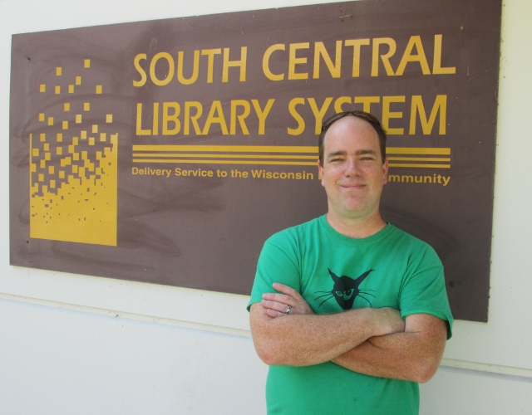
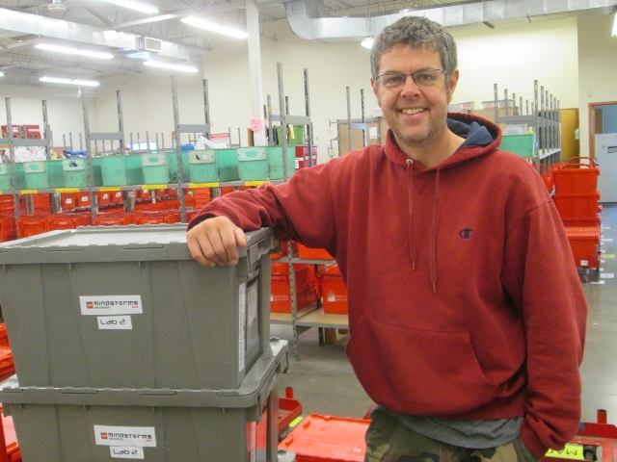
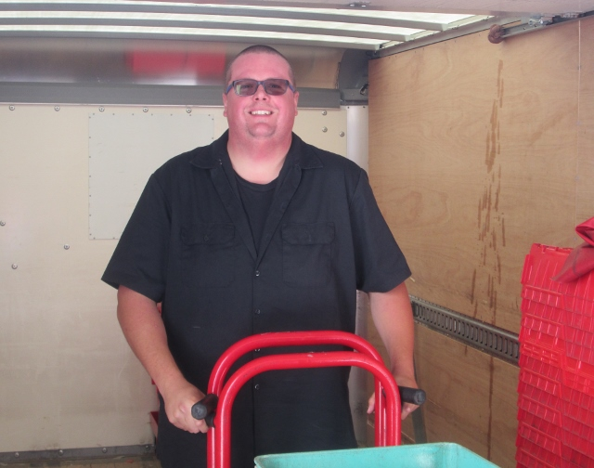
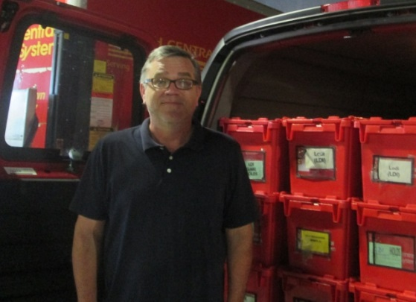
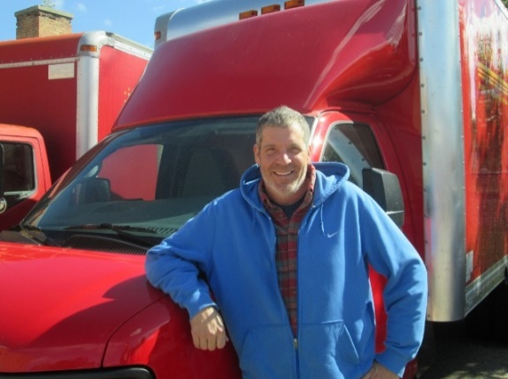
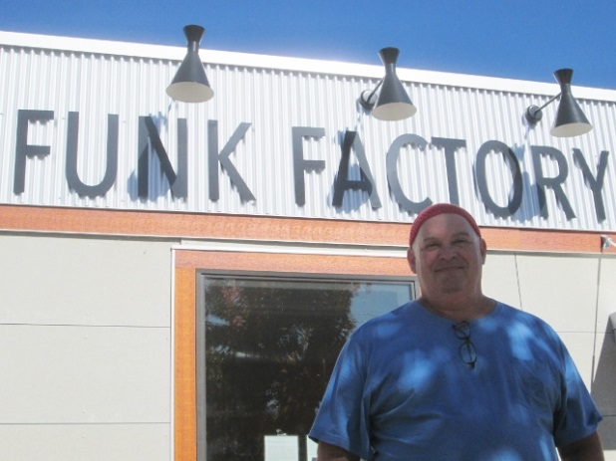

Slide 4
14 Full Time Driver/Sorters
8 Part Time Driver/Sorters

Slide 5
14 Full Time Driver/Sorters
Almost 180 years of driving experience
9 Drivers have more than 15 years
Average: 13 years
Most: 27 & 25
8 Part Time Driver/Sorters
Over 40 years of driving experience
4 Drivers have more than 5 years
Most: 13

Slide 6
7 Management Staff
Fleet
Operations
Supervisors
Almost 140 years of service (20 each!)
Duties: Route management, scheduling, training, substituting, building management, shift coverage, customer service

Slide 7
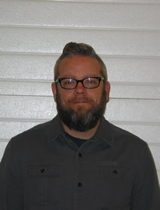
Fleet Manager
Jesse Stewart

Slide 8
Where do we go?

Slide 9
Mileage Breakdown: 376,000 miles

Slide 10
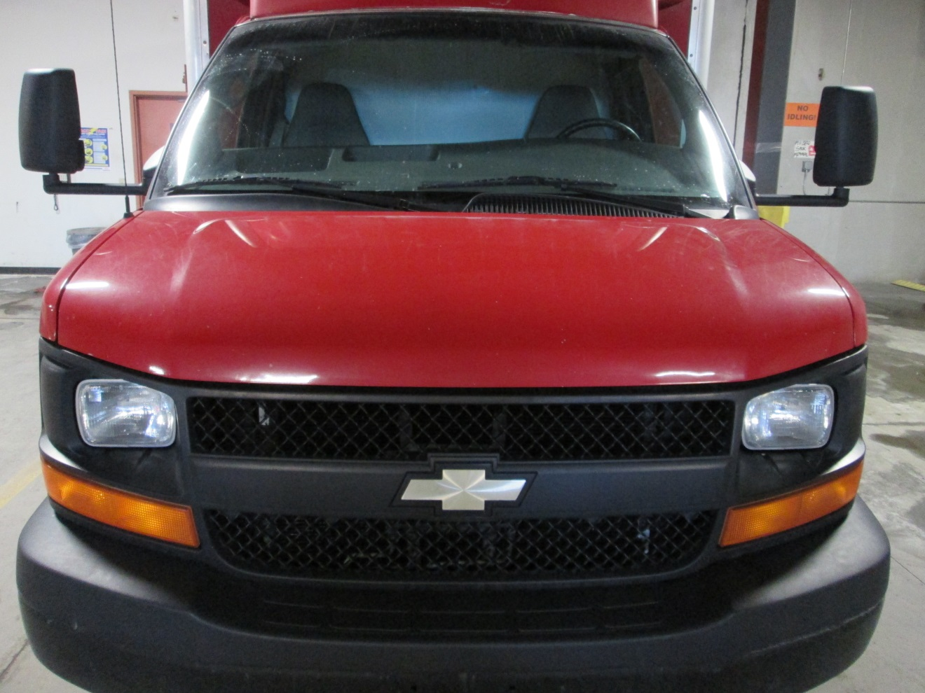
Fleet Profile

Slide 11
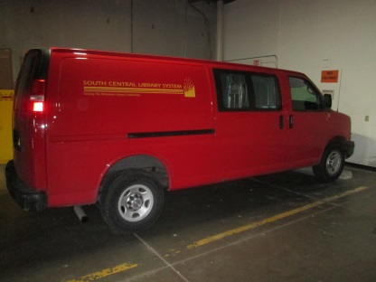
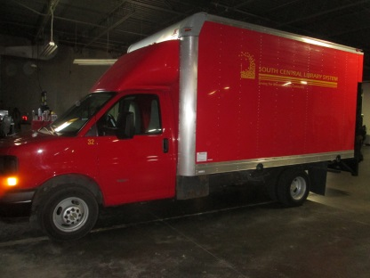
Fleet Profile
12 Cargo Vans
Longer routes/Less volume
Regular unleaded
7 box Trucks
Equipped with powered lifts for cart transfer
Local/heavier routes
Diesel & Regular
3 Box trucks have a shorter box, saving upfront cost

Slide 12
Fleet Profile
With over 670,000 miles:
Vans and Trucks are rotated depending on age, condition, and mileage
New acquisitions are normally based on retiring (selling) vehicles that are at or near the 350,000 mile mark. We will add either two new vans a year or a van and a truck (typically)
Many of our drivers put on over 70,000 miles a year. That is 5 to 6 times more than the average driver will under normal driving routines.
We keep them so well maintained that we have had auction sales of 15 year old trucks for around $5000.

Slide 13
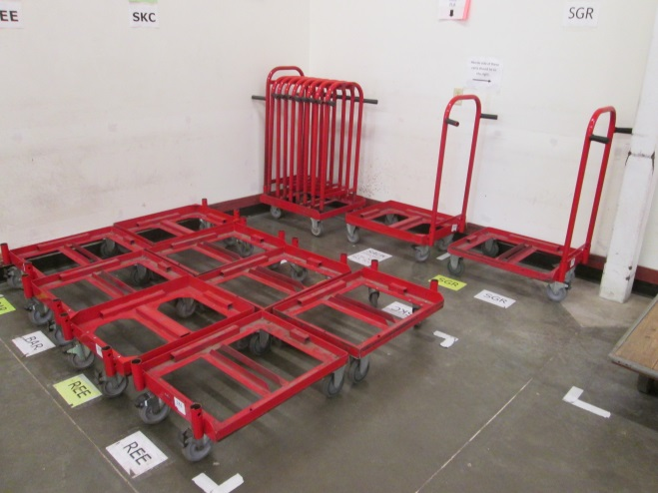
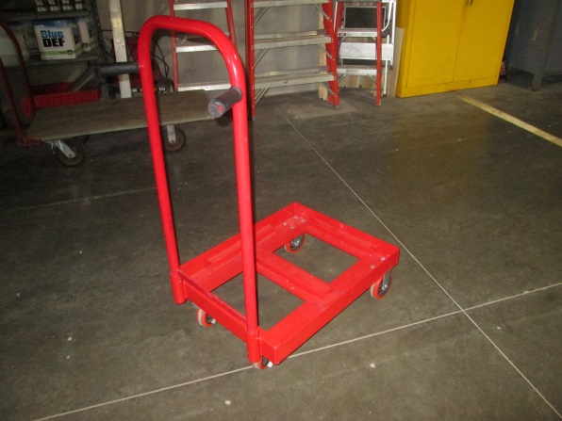
Equipment
Red Carts:
250 existing steel red carts
Acquired beginning around 2004-2005
Approximately $300
New aluminum
Just ordered from Hoffman Manufacturing
$360 each

Slide 14
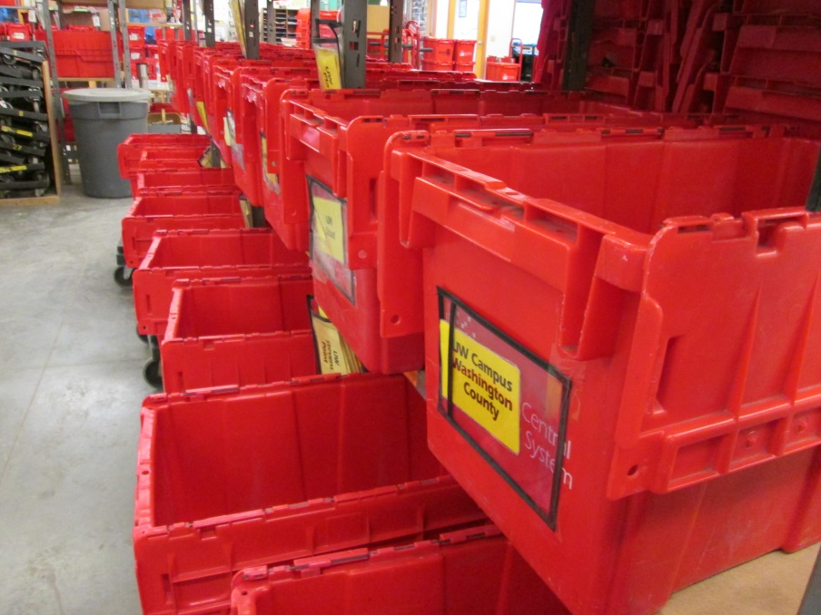
Equipment
Baskets:
2020 purchases bolstered a declining supply
We have a significant surplus
Purged hundreds of bins this summer to recycling

Slide 15
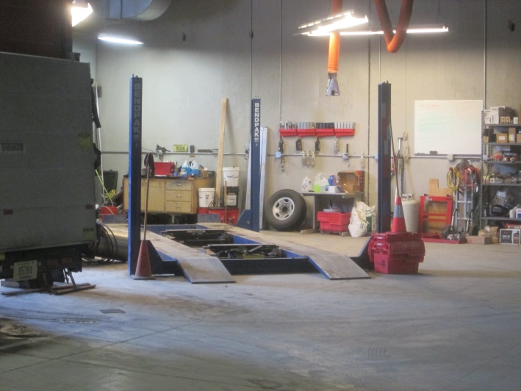
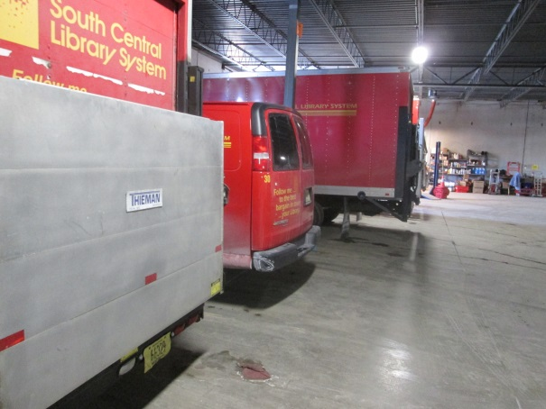
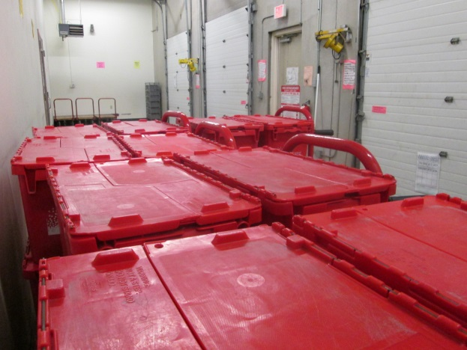
Facility
1601 Gilson Street:

Slide 16
Facility
1601 Gilson Street:
3,770 square feet for sortation and storage
Not including the 3 bay loading dock
Indoor parking for up to 13 trucks
Maintenance bay with a vehicle lift
Detached garage for additional storage and parking
$14,266 per month in December
$170,000 per year
Delta Property Management

Slide 17
Volume Breakdown

Slide 18
Volume Trending

Slide 19
Bins per month – 3 month averages

Slide 20
Effect of the pandemic

Slide 21
Statewide Coordination
SCLS was recommended and approved to be the statewide delivery coordinator.
Began meeting this role in August and there are 2 primary work groups:
Data Collection and Cost Analysis
Private Courier Standards
Implementing PLSR (Public Library System Redesign) recommendations for Hub Model

Slide 22
Statewide Coordination
How does SCLS Delivery Evolve?
Less direct delivery to statewide locations
Handing off “last-mile” stops to local couriers
Operating with better efficiency and less duplication of effort
Concentrating resources where we are better positioned: locally and regionally

Slide 23
Statewide Coordination
How does SCLS Delivery Evolve?
Careful evaluation of our coverage area for both fleet and staffing
Seeking opportunities to provide service where we can
Managing the shift in resources that will come with other couriers providing local services
Staged process that begins in 2022.
Southwest and Winding Rivers partnerships
Milwaukee and the Fox Valley coming in 2023

Slide 24
Challenges:

Slide 25
Challenges:
Salary/Hourly Pay
Fleet: Maintaining a healthy number of vehicles
Transition away from our wide reach

Slide 26
Rewards:

Slide 27
Rewards:
Experienced, flexible, and knowledgeable staff
Support and Input from Administration
Support from our statewide partners

Slide 28
Thank You

