Slide 1
Building needs assessment workgroup (BNAW)
Update March 2022

Slide 2
charge
The purpose of the Building Needs Assessment Work Group (BNAW) is to research and recommend to the SCLS Board of Trustees, SCLS staff and member libraries the most efficient and cost effective facility/facilities to best serve all departments and customers of the future SCLS organization.
BNAW will serve as a forum for discussion and decision–making concerning SCLS facilities including location, size, cost and function while realizing that authority for building and land purchases rests with the system board.

Slide 3
description
The Building Needs Assessment Work Group (BNAW) is composed of representatives of all SCLS departments and the SCLS Board of Trustees. BNAW will report out at all regularly scheduled Administrative Council and All Directors meetings. These meetings will provide input to BNAW from the SCLS member libraries.
Currently SCLS rents two facilities with leases that expire in 2023. It is the goal of the BNAW to complete a recommendation that allows implementation of its facilities plan before the leases expire.

Slide 4
goals
Design a building that operationally meets our needs better.
Achieve savings.
Facilitate more team work and unite culture between administration and delivery.

Slide 5
Work to date: 2018
2018: Spent the end of the year outlining our goals, charge, budget, financing options and evaluating the SCLS building needs.
Utilizing meetings, focus groups and surveys, compiled a master list of building needs and wants. Must have, nice to have, pie in the sky list.

Slide 6
Work to date: 2019
2019: Spent the year selecting a builder. Through a process of inviting builders in to do presentations, followed up by a request for information, evaluated using a scored evaluation matrix, and followed up with site visits, selected the Design-Build firm Keller, Inc.
Keller is a Design-Build firm that will assist SCLS through all phases of design and construction, to include site selection and evaluation, budgeting and the public bidding process.
Keller primarily works with public projects and is able to work within the SCLS budget.

Slide 7
Work to date: 2020
2020: Worked with Keller to create a Discovery Booklet, created by having Discovery meetings with all staff and departments, to outline building needs/wants.
Keller created this booklet that outlines space needs, square footage and estimated budgets for the project.

Slide 8
Work to date: 2021
2021: Site selection, Financing and Floor Plans
Worked with Keller and Lighthouse Realty on site selection. Criteria used in site selection included location (near major highway systems for Delivery), cost, on MUFN map, cellular service, on bus route, other services/amenities available in the area, walkable neighborhood.
The final site selected that met all criteria is at 2801 Walton Commons Lane in Madison. A purchase and sale agreement has been drafted and signed with the City of Madison, with the goal to close on the sale of the property by May 2022.
Secured financing for the project through the Board of Commissioners of Public Lands.
Spent the year drawing up floor plans and construction documents.

Slide 9
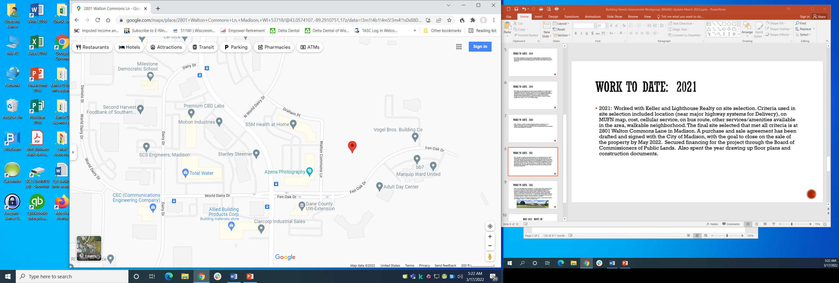
Site selection: 2801 Walton commons lane

Slide 10
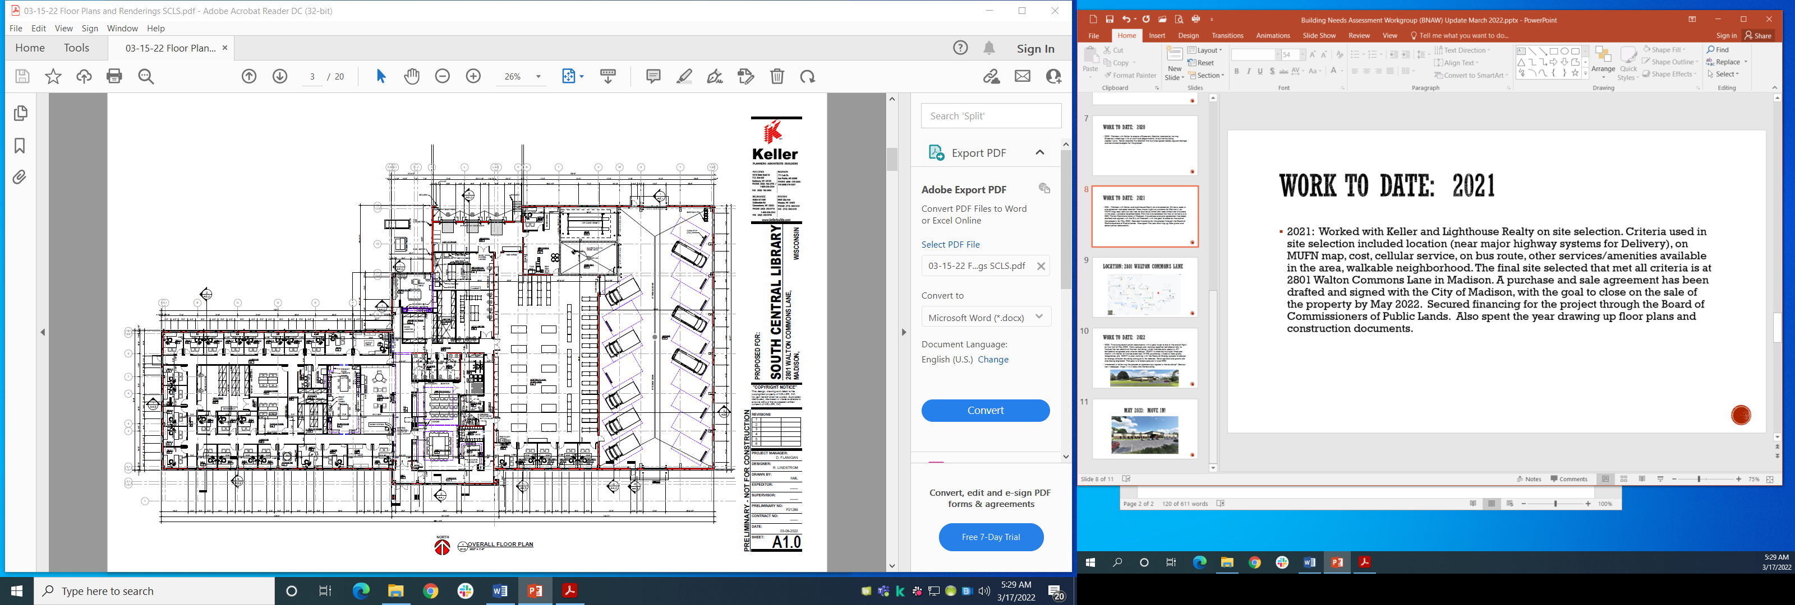
Floor plans

Slide 11
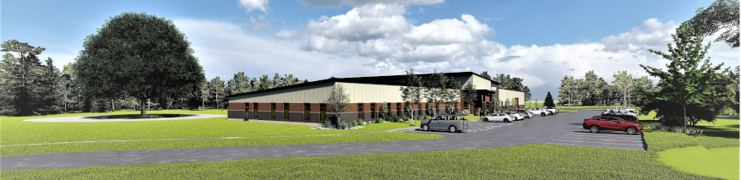
Work to date: 2022
2022: Finalizing construction documents with a goal to go to bid at the end of April or first half of May 2022.
Many groups are working together collaboratively to finalize the last details of the new building, which include data, security, AV, collaborative spaces and interior design. BNAW is meeting multiple times per month with Keller to finalize electrical, HVAC, plumbing, windows, floor plans, telephones, etc.
BNAW is also working with the Focus on Energy project to design an energy efficient building and qualify for rebates. Solar options and grants are also being explored. The goal is to break ground in June 2022.
Interested in following the project or sponsoring a space in the building? See our new webpage: https://www.scls.info/new-building

Slide 12
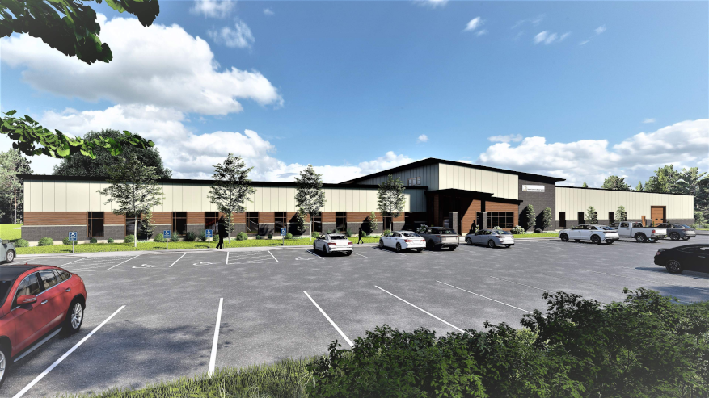
May 2023: move in!

Slide 13
Budget considerations: administration
TOP 3 BUDGETARY FACTORS MOVING INTO 2023-2024
System State Aid
  New formula?
  Effect on SCLS
PLSR
  Delivery hub implementation
  Impact on SCLS Delivery operations and budget
New Building Budget
  Impact of pandemic on building supply chain and cost of materials

