Slide 1
Delivery - 2023
Challenges, plsr, & cost formula

Slide 2
Update:
Tim Drexler has moved over to SCA
Brad Guenther has assumed new duties to cover Tim’s departure
Intersystem route coverage (Portage Co, Sauk, and Adams Wood)
Assisting with Statewide coordination
Jeff Grandt-Turke has filled the vacancy created by Tim’s departure
Added Green, Columbia, Dane North, & Dane South (from brad)

Slide 3
challenges
Inflation:
Fuel
Supplies
New/used trucks
Wages
Contracted services

Slide 4
Fuel
Since last march, fuel has increased over:
25%
And we are using 10% more fuel to accomplish 5-day statewide delivery

Slide 5
Motor oil: oil changes
Motor oil has doubled
From $380/barrel to $740
Purchased approximately 3 times a year

Slide 6
Post its
From $1.10 per pack of 1200 to $1.48
Currently not in stock!!

Slide 7
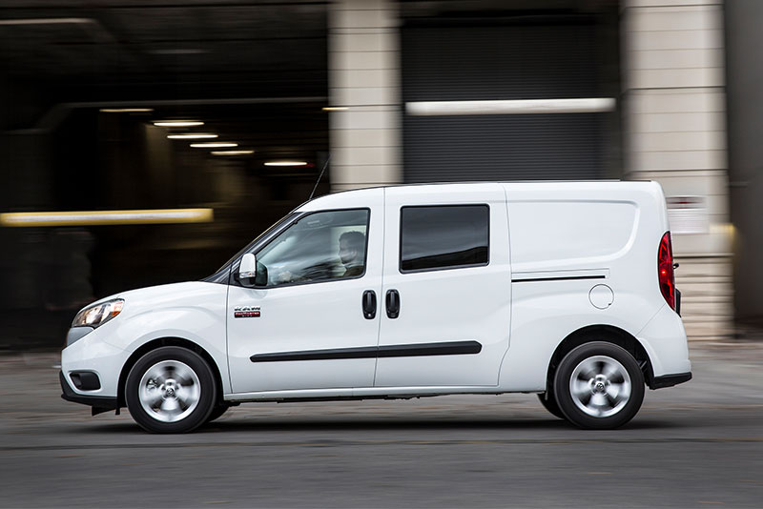
Truck purchases:
In 2021, we paid for 1 used truck and 1 new
No incentives were offered
Picked up from La Crosse and Platteville
The new truck was about 30% more than previous new trucks
Other systems are scrambling to find trucks
We sold 3 old vehicles at a very high return (the opposite of what we see in purchasing)

Slide 8
PLSR
Implementation workgroups progressing
Volume, delivery system costs
Delivery standards
Prelude to expanded implementation of PLSR HUB model
Northeast
Southeast
Current model:
Waltco to La Crosse
Exchange with Southwest in fennimore

Slide 9
Cost formula
Met last month; will be scheduling a meeting to update with some variations of how costs can be distributed
Rapidly changing environment in terms of cost impacts on delivery

Slide 10
Cost formula:
Nominal Base Fee
Volume Based Fee
Postalized Fee for Stop Count
Applying State Aid
“Shelf” Fee
-Supplies, operating, & Management
Sorting & Handling Costs
Fleet: Fuel, Mileage
Assessing our costs

