Slide 1
Welcome to the SCLS May 2022 All Directors Meeting!

Slide 2
Administration and Consulting Services Revenue Considerations in 2023
Anticipated Increases in Revenue:
State Aid: Increasing $206,079
Foundation Admin Fees: Anticipated increase of $7,800
Anticipated Decreases in Revenue:
WLA Rent: $13,510
Interest Income: $2,480
Total Overall Increase: $197,889

Slide 3
Administration and Consulting Services Expense Considerations in 2023
Anticipated Increases in Expenses: $371,843
Out of System Interloan (WorldShare ILL): $990
Online Content and Memberships (WorldCat, WPLC, SRLAAW): $1754
Consultant Salaries: $2,319
Continuing Education and Mileage: $6,241
New Building Expenses (CAM, Moving, Equipment Replacement, HVAC): $74,281
Facility (Utilities, Janitorial, Offsite Storage): $22,600
HQ Portion of the Mortgage: $249,823
Supplies, Telephone: $1,025
Worker’s Comp, General Insurances, Unemployment: $4,010
Audit, Bookkeeping, FSA, Banking Fees: $4,300
SCLS Computer Hardware and Supplies: $4,500
Anticipated Decreases in Expenses: $278,817
Workforce Development: $788
Continuing Ed and Professional Development: $21,500
Admin Salaries: $9579
HQ Rent (only 5 months): $128,017
Library Equipment Grants: $100,000
Employee Insurances: $11,943
Retirement and FICA: 6,990

Slide 4
2023 Budget Summary Administration and Consulting Accounts
Revenue:
Overall increase of $197,889
Expenses:
Overall increase of $93,026
Revenue Allocated to Other Member Services: $104,863

Slide 5
New 2023 Consulting Services Grants
Training Grants (to supplement continuing ed/prof development ):
Professional Learning LSTA: $27,018
SCLS is the Fiscal Agent for:
Trustee Training LSTA: $3,000
IDEA Project Grant: $25,000

Slide 6
General Carryover Fund
Planned use of General/Delivery Carryover funds in 2022:
1 Delivery Van and 1 Delivery Truck ($86,000)
This will leave the General/Delivery fund at a beginning 2023 balance of approximately $741,987. Per the SCLS Carryover Policy:
A portion of the general fund must be maintained to cover outstanding liabilities.
The remainder may be allocated to fund projects, purchase materials/equipment, finance system/county consolidation efforts or any other use deemed appropriate by SCLS or the Board of Trustees to be of member or system benefit.
Future considerations for use of the General/Delivery Carryover fund into 2023 will include the SCLS building project. Up to $500,000 has been approved.

Slide 7
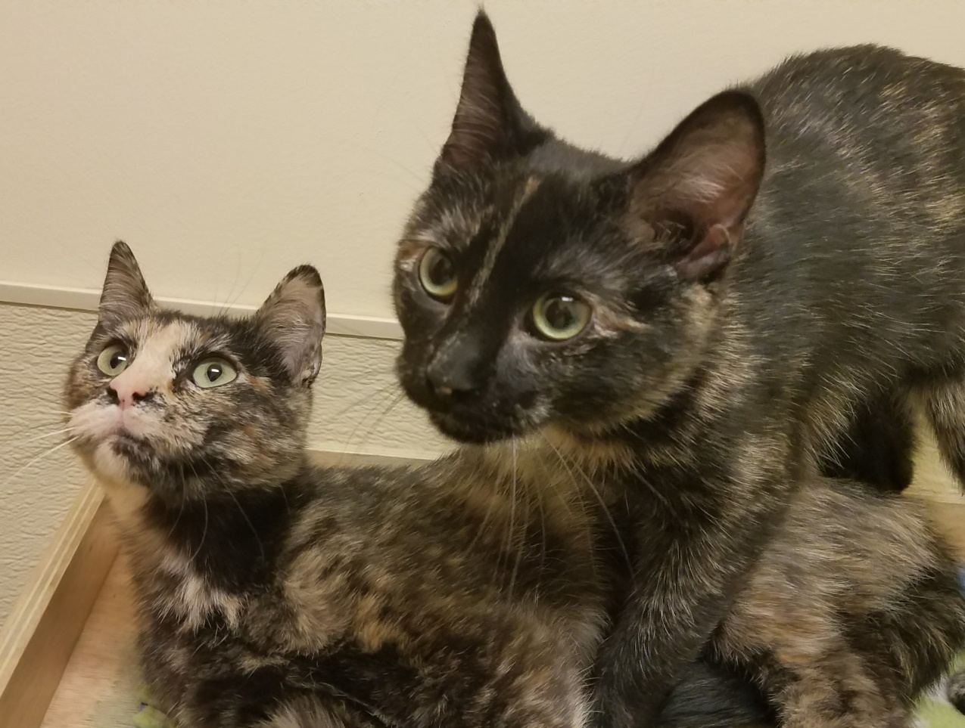
Questions?

