Slide 1
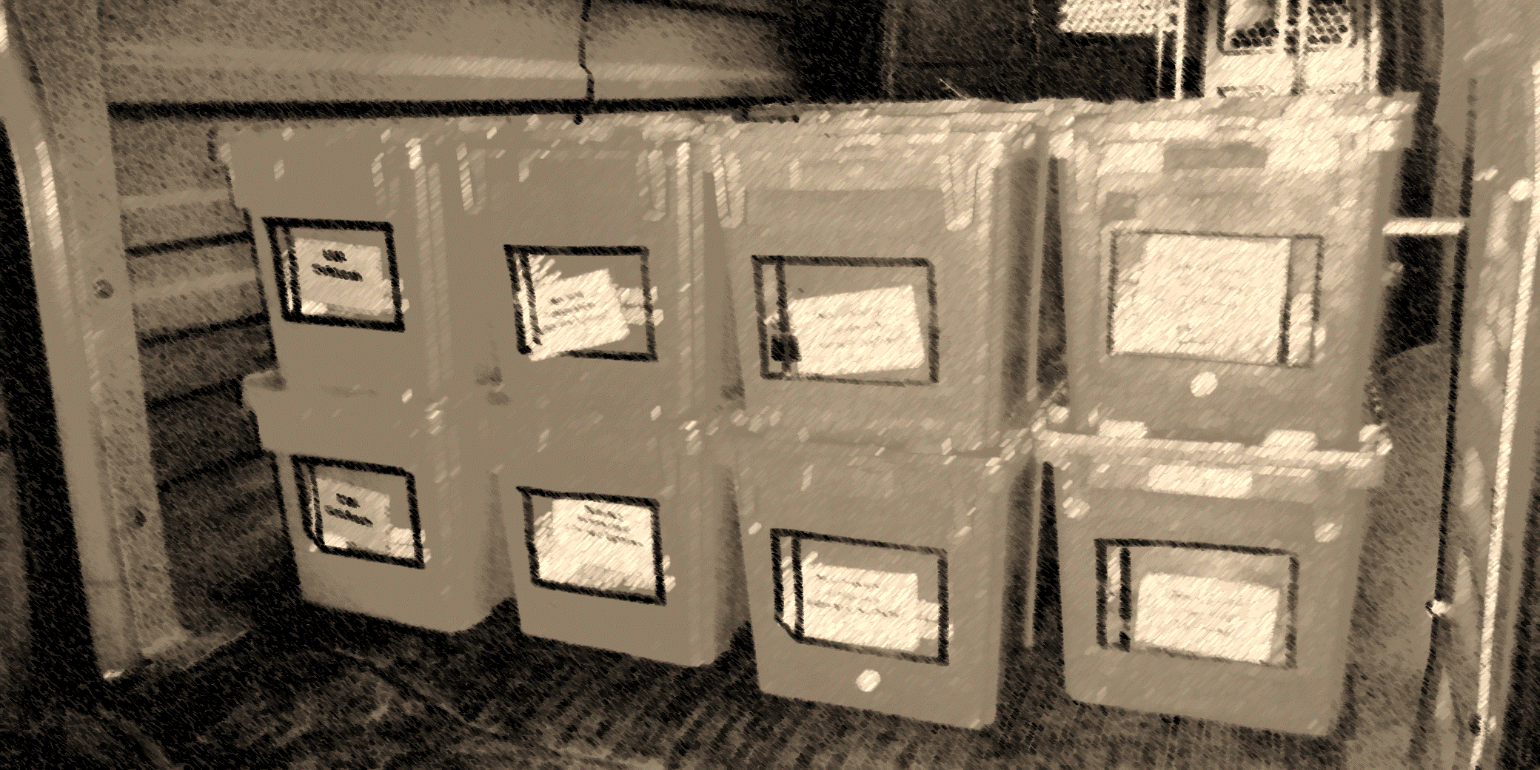
Delivery report to the Board of Trustees 2022
Corey Baumann, Delivery services Coordinator
10/27/22

Slide 2
Subjects:
Public Library System Re-Design
Size and scope of our service
Who we are
SWOT (strengths, weaknesses, opportunities, threats)

Slide 3
Public Library System Re-Design (PLSR)
Delivery Overview
Progress to date
Challenges to implementation and outlook

Slide 4
PLSR Delivery overview
Hub model vs. Direct Handling by SCLS
Instead of a network web centered in Madison at SCLS with deliveries made to most participants (15 systems and two-dozen UW campuses), SCLS would partner and facilitate “hand-off” to local systems for “last mile” delivery.
Reduces redundancy /Increases efficiency

Slide 5
PLSR Delivery Progress to date
SCLS facilitated a new route structure in 2022 that:
Increased our statewide frequency from 4 to 5 days
Coordinated a hand-off at Southwest Wisconsin Library System to handle delivery to UW Platteville and UW Platteville-Richland Center. Both of which were direct delivery from SCLS
Coordinated a hand-off via Waltco to Winding Rivers Library System in La Crosse to handle delivery to UW La Crosse and Viterbo University.

Slide 6
PLSR Delivery challenges
Cost
Systems performing delivery have costs and they have accelerated this year (inflation, fuel)
Coordination and Delay
Handing off creates a 24 to 48 hour delay for materials in transit
Timing delivery stops to best coincide with work-flow is challenging when working with “conjunctive” couriers

Slide 7
PLSR Delivery challenges
Quality Concerns
With delays and coordination concerns comes increased risk of lost and damaged materials
Most commonly, the inconsistency of arrival times or completed routes is most frequent
Communication does not adequately meet expectations

Slide 8
PLSR Going Forward
2020 and how we all emerged: Tight budgets, competition for resources, COVID impacts, etc.
Service and Staffing have evolved
Service stability and cost
Is the whole PLSR Delivery model still valid? (now 5 years down the road)
Should it be evaluated and adjusted to better emphasize stable partners?
Should statewide delivery be de-emphasized?
Are there cost vs. quality decisions to be made?

Slide 9
SCLS vs other system Delivery
SCLS has a very robust and long-standing member delivery service. Emphasis has always been on quality, frequency, and stability.
Other systems have ranges of service from 3-day private contracts (conjunctive) to 5-day system provided service. All have very good reviews from their membership satisfaction surveys.

Slide 10
SCLS vs other system Delivery
SCLS provides the highest quality and largest volume of material movement statewide. It comes at significant cost.
Quality: Safe, reliable transportation with high levels of problem solving and maintenance of service consistency controls
Lost items are exceedingly rare. Damage is managed and accounted for.
Unlike other providers, it is the service you would expect and appreciate.

Slide 11
Size and Scope of SCLS Delivery (direct):
65 member library destinations
13 Direct service stops at Wisconsin library system headquarters
18 University of Wisconsin System campuses
11 Statewide Private Colleges
6 Technical Colleges

Slide 12
Distance Traveled?
600,000 and 650,000 miles per year
To the moon and back by October 1st
New York to Los Angeles every day

Slide 13
People:
2014
2022
14 Full Time Drivers
7 Managers
12 Part Time Drivers
13 Full Time Drivers
6 Managers
8 Part Time Drivers

Slide 14
Driver Seniority:
Full Time: Over 235 years
Part Time: 40 years with 8 staff members
Chained together, that would take us back to the birth of the US Constitution!
94 years with our 6 managers (15+ years per person)
17+ if you remove Corey!

Slide 15
Gas
Time Sample | Gallons Purchased | Net Cost | Per Gallon
Per month 2021 | 3394 | $8,465 | $2.76
Per month 2022* | 3485 | $12,050 | $3.46
October 2022 | 3061 | $11,327 | $3.79
*Before Measures

Slide 16
Volume change to members – One week in October
Year | Monday | Tuesday | Wednesday | Thursday | Friday | Saturday | Total
2015 Drop | 415 | 574 | 545 | 476 | 446 | 247 | 2703
2015 Pick | 604 | 600 | 499 | 483 | 475 | 231 | 2892
2022 Drop | 446 | 567 | 482 | 395 | 351 | 0 | 2241
2022 Pick | 671 | 460 | 414 | 419 | 382 | 0 | 2346
2022 Change | +7.5% | -1.2% | -11.6% | -17.0% | -21.3% | -100% | -17.1%
 | +11.1% | -23.3% | -17% | -13.3% | -19.6% | -100% | -18.9%

Slide 17
Fuel Comparison
Before Fuel Savings Initiative (Avg Monthly Jan-May 2022)
After Fuel Savings Initiative (9/15-10/15)
Total Gallons: 3485
Diesel Gallons: 230
At October prices, we would have spent $1158 more than had we not instituted changes to routes.
Total Gallons: 2989
Diesel Gallons: 209
October Diesel was a $100 savings

Slide 18
One last cost comparison

Slide 19
SWOT for Delivery
Our strengths ARE our weaknesses:
High Seniority. Dependable, knowledgeable and nearing personal decisions on longevity
Opportunity:
Stability, demonstrated quality, reputation
Centrally located to provide dependable service
Threats:
Resource Competition
Employment opportunity: attracting and keeping staff members

