Slide 1
SCLS Local Holds Pilot: Preliminary Data
Tim Drexler • SCLS Data Services Consultant
All-Directors Meeting • 11.17.2022

Slide 2
Concern:
Will circulation increase
or decrease?

Slide 3
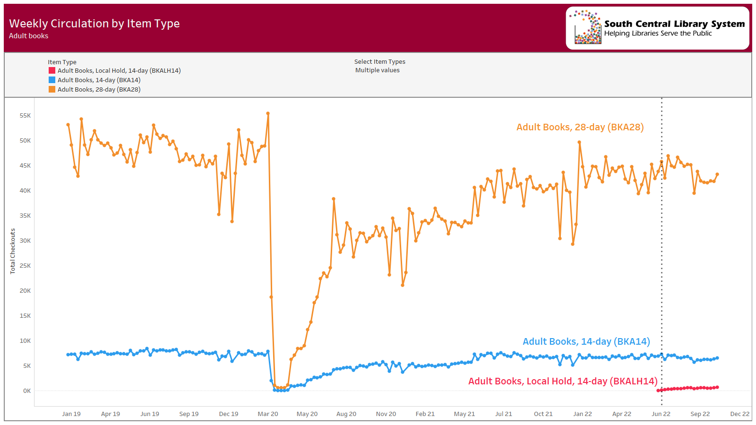

Slide 4
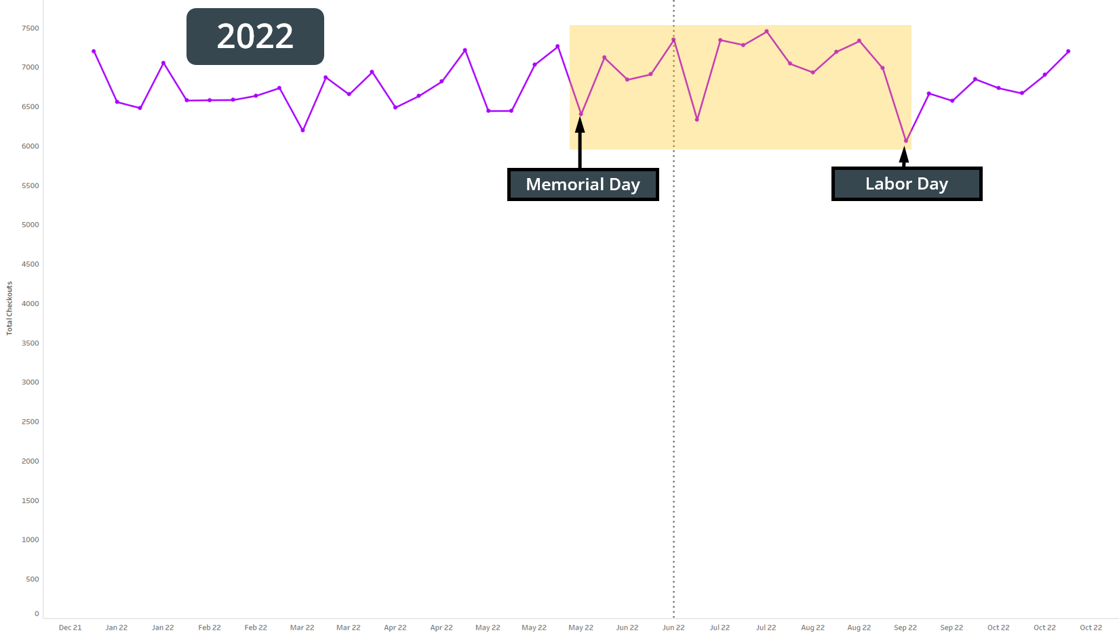
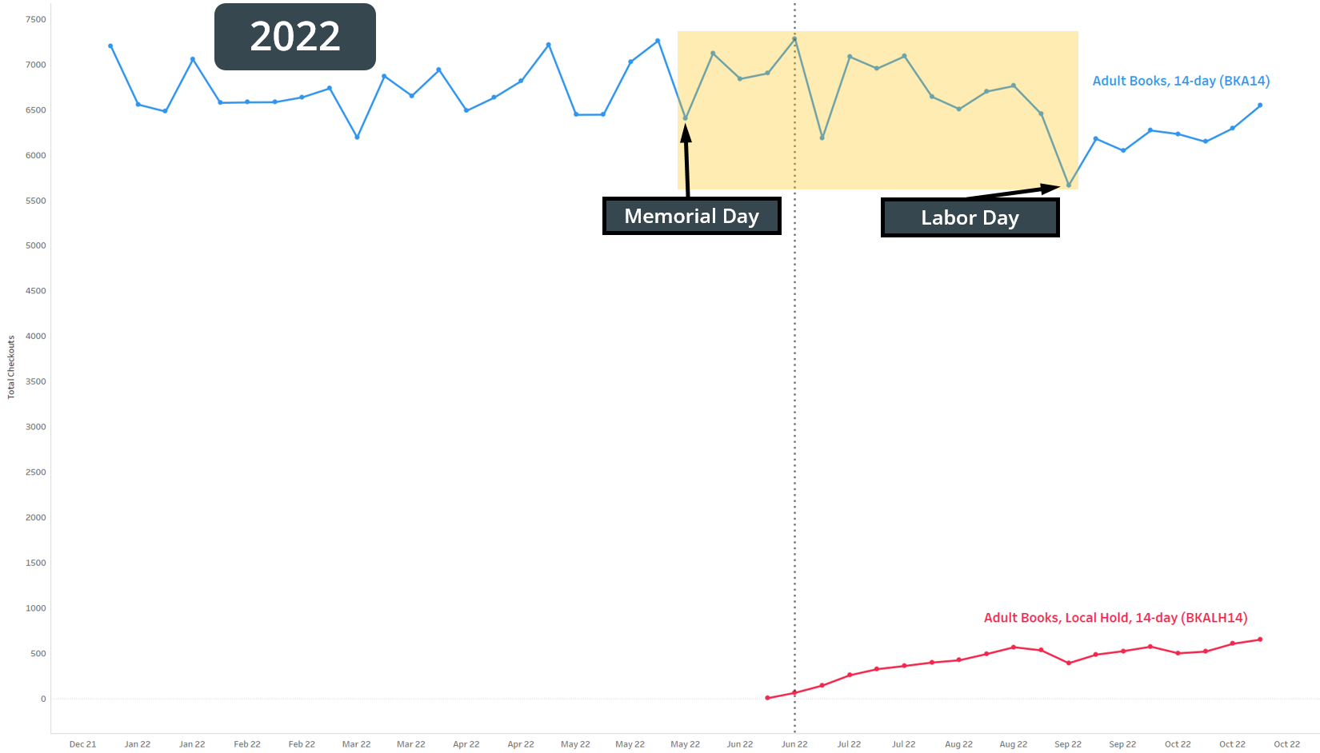
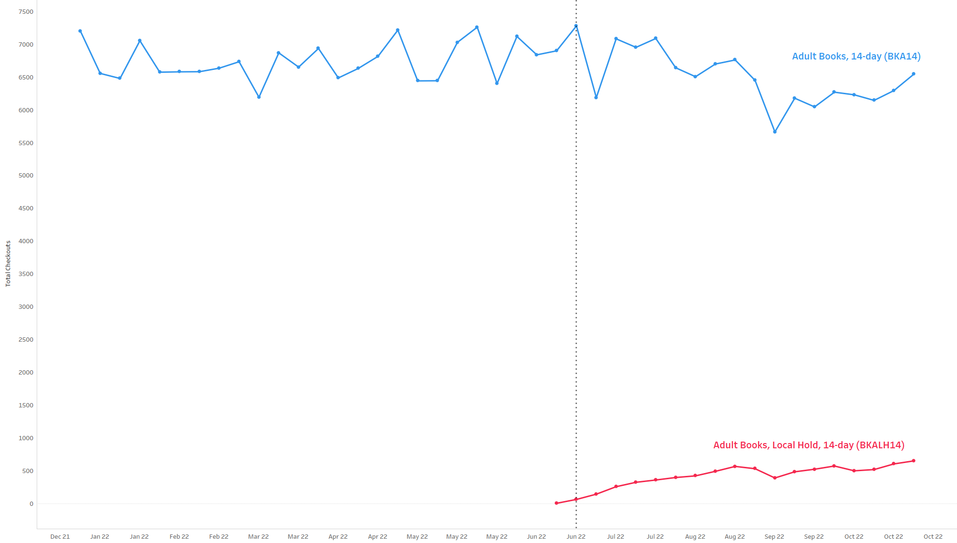

Slide 5
Concern:
Will local holds increase or decrease waiting time for holds?

Slide 6
A bit of math
“Days to Fill” = (date hold was filled) - (date hold was placed)
For any given time period:
Count the number of filled holds
Sum the “Days to Fill” for all filled holds
Average Length of Time to Fill Holds = Total “Days to Fill” / Number of filled holds

Slide 7
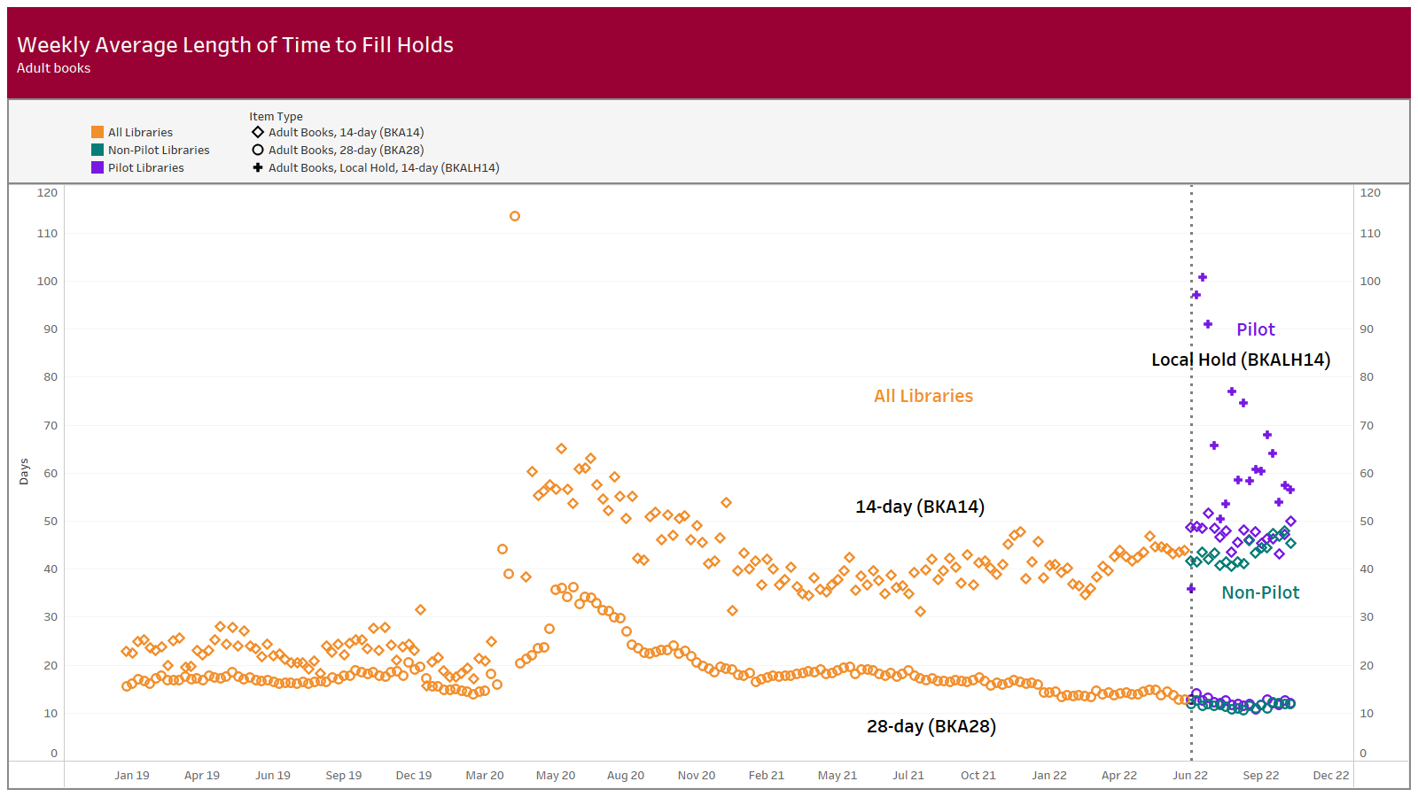
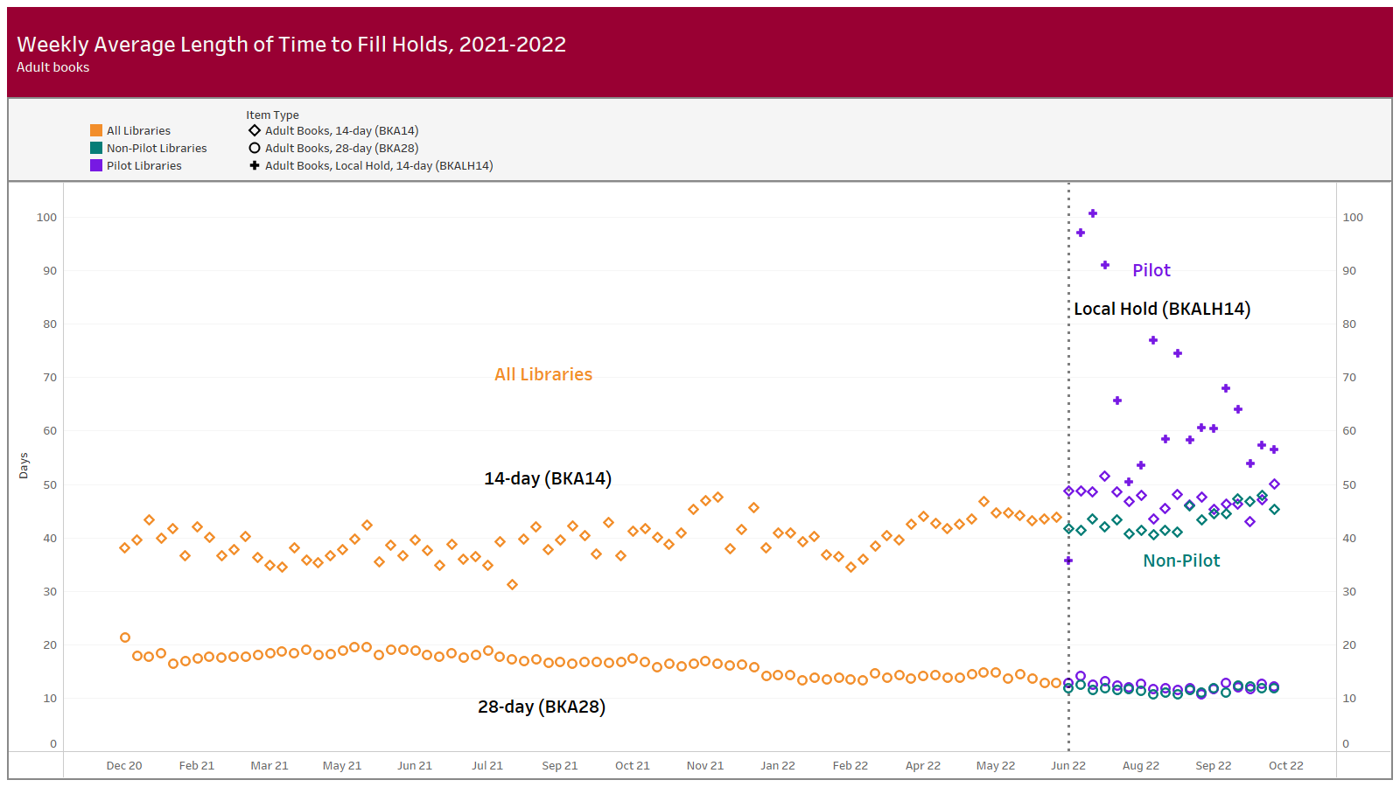

Slide 8
Questions
Tim Drexler • SCLS Data Services Consultant
tdrexler@scls.info • 608-246-7973

