Slide 1
SCLS DATA SERVICES:
Solving Data Challenges
Tim Drexler
SCLS Data Services Consultant
November 18, 2022

Slide 2
My Background at SCLS
SCLS Delivery
1999 – 2000: Part-time driver
2001 – 2021:
Assistant
Operations
Delivery
Supervisor
Support
Manager

Slide 3
Lifelong Learning
UW-Madison, 1996 – 2000
BA, English Literature
UW-Milwaukee, Apr 2016 – May 2017
BS, Information Science & Technology
Online through UW Extension FLEX program
UW-Oshkosh, 2018 – 2021
MS, Data Science
Online, collaboration of UW Extension and 6 UW campuses

Slide 4
What I Love About Data Services
Continual learning:
New tools
New techniques
Cross-domain
Problem-solving

Slide 5
Challenge:
Find a way collect and process votes while conducting All-Directors meetings in a hybrid format.

Slide 6
Spreadsheets
Basic, familiar, widely-used
Great for checking results
Complex function programming

Slide 7
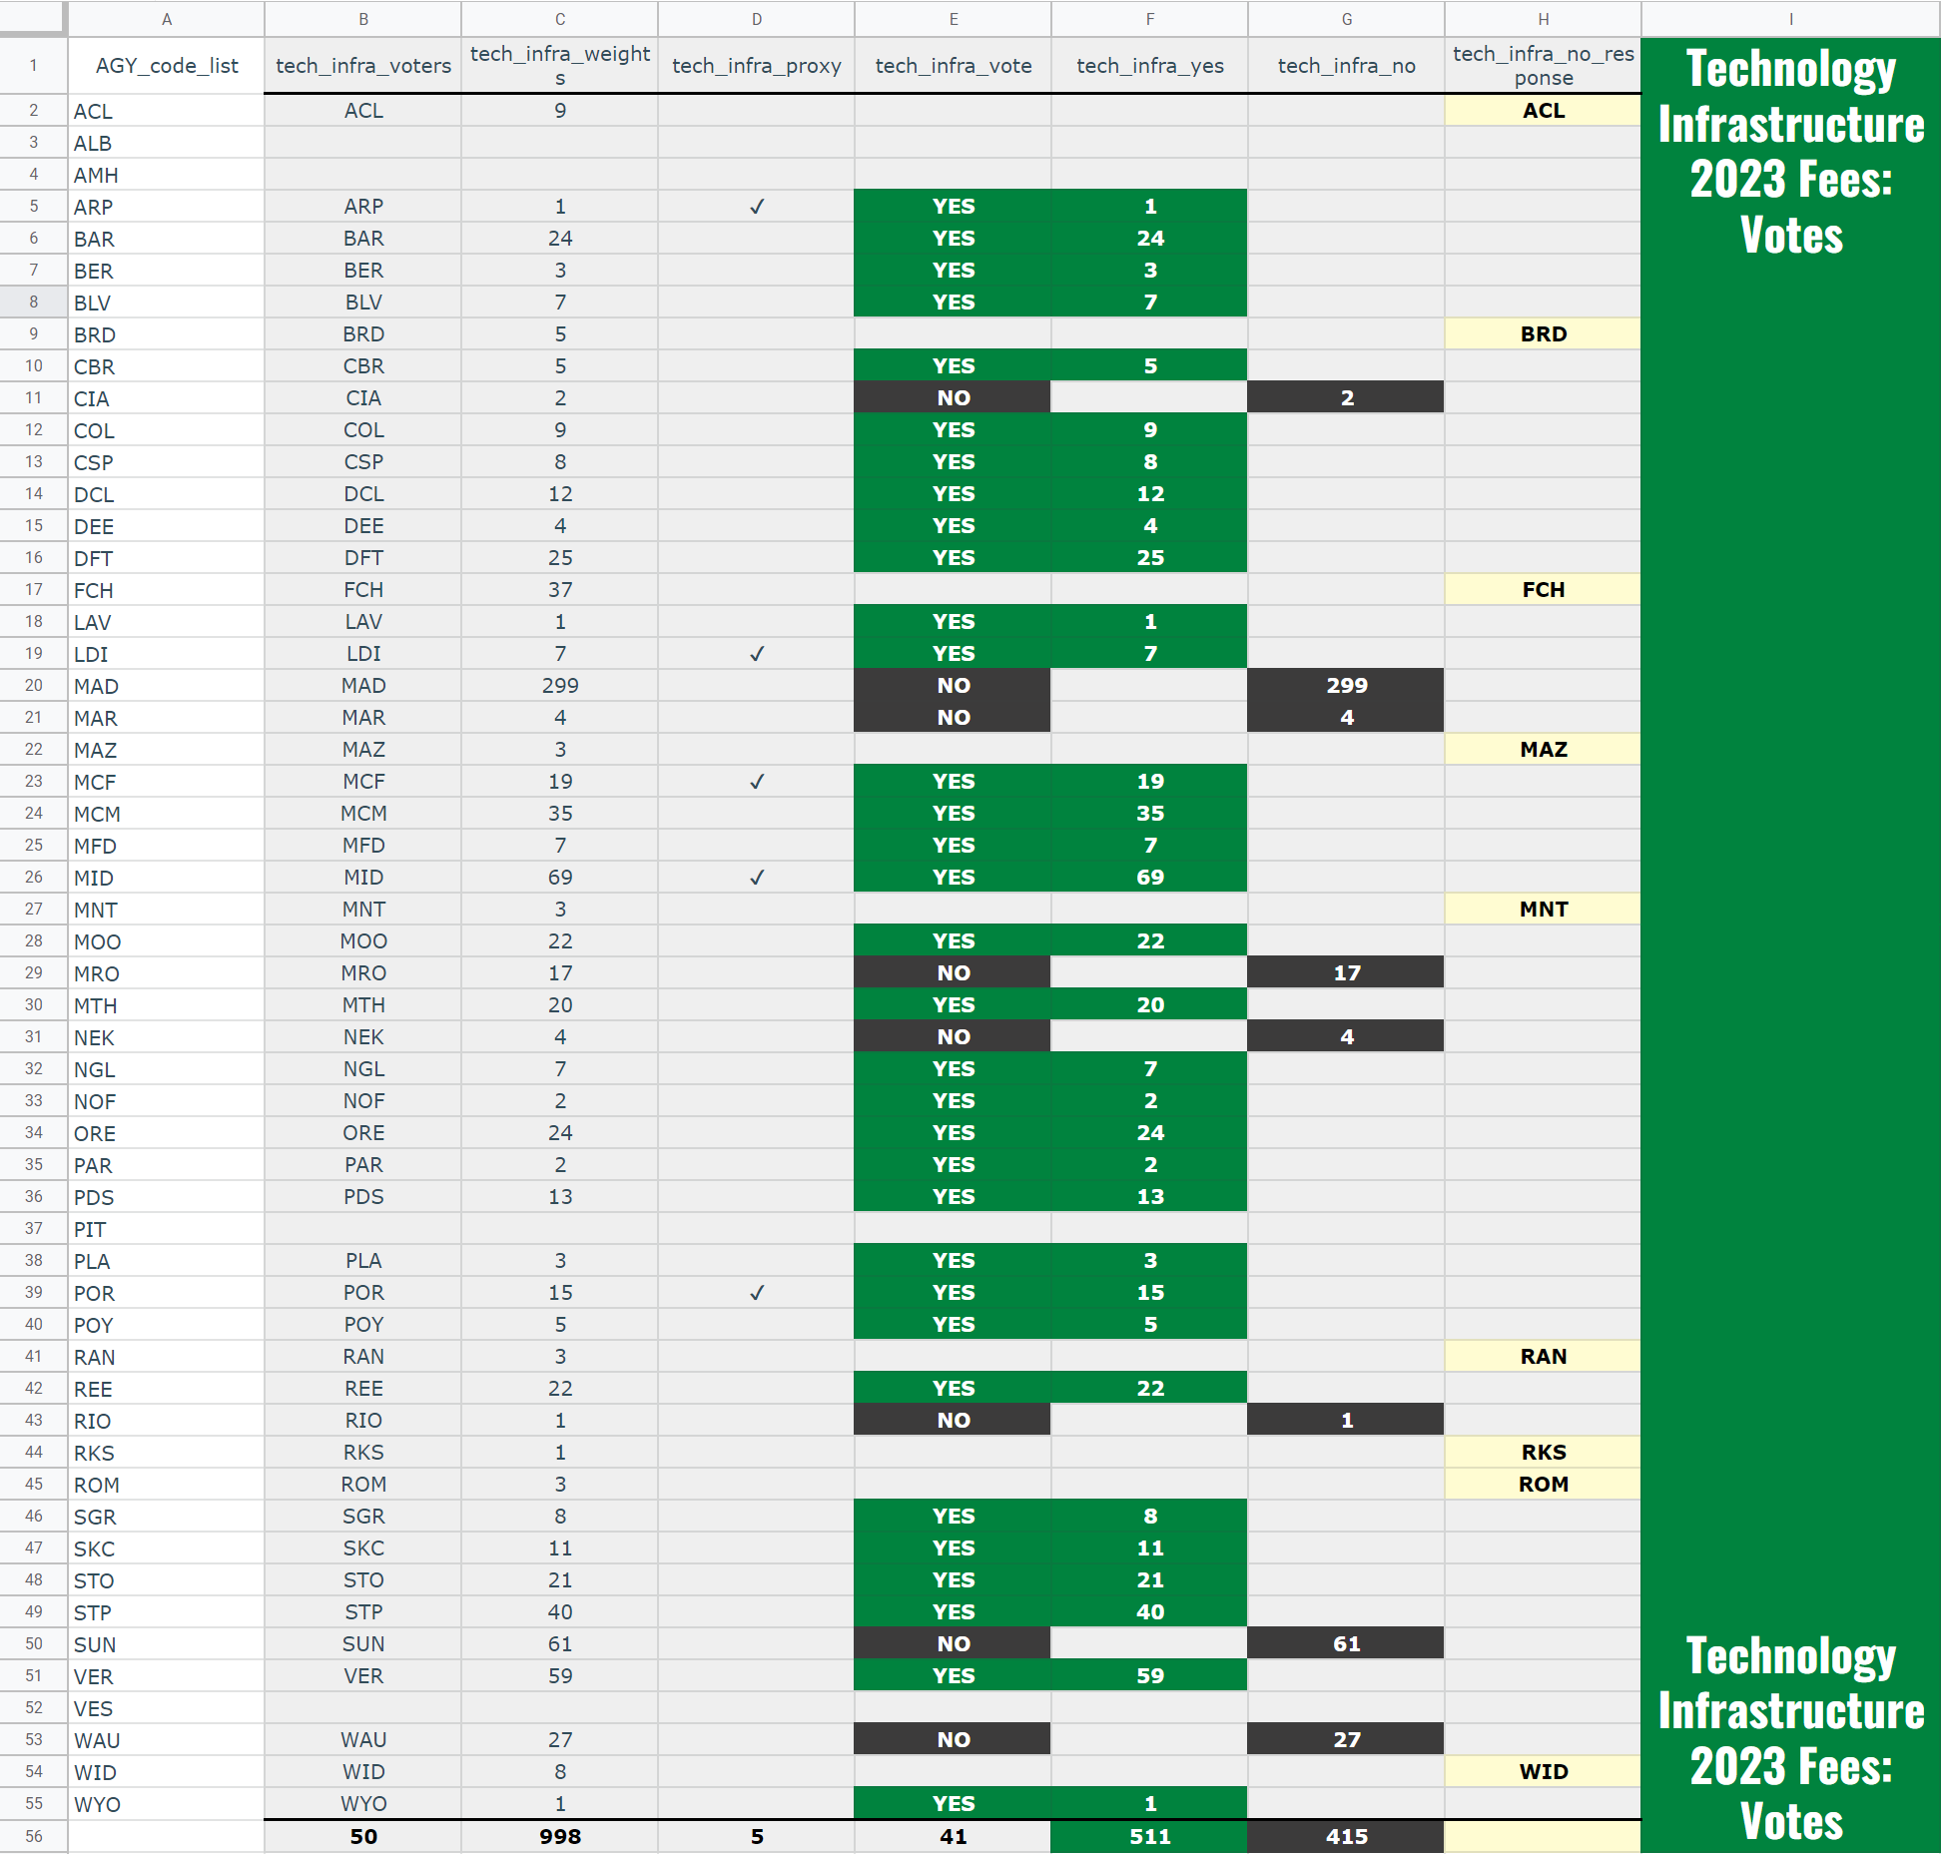

Slide 8
Challenge:
Identify peer libraries and compare staff salaries on behalf of libraries looking to fill vacant positions.

Slide 9
Python
Open-source, all-purpose programming language
Data gathering and cleaning
Pandas package
Automation

Slide 10
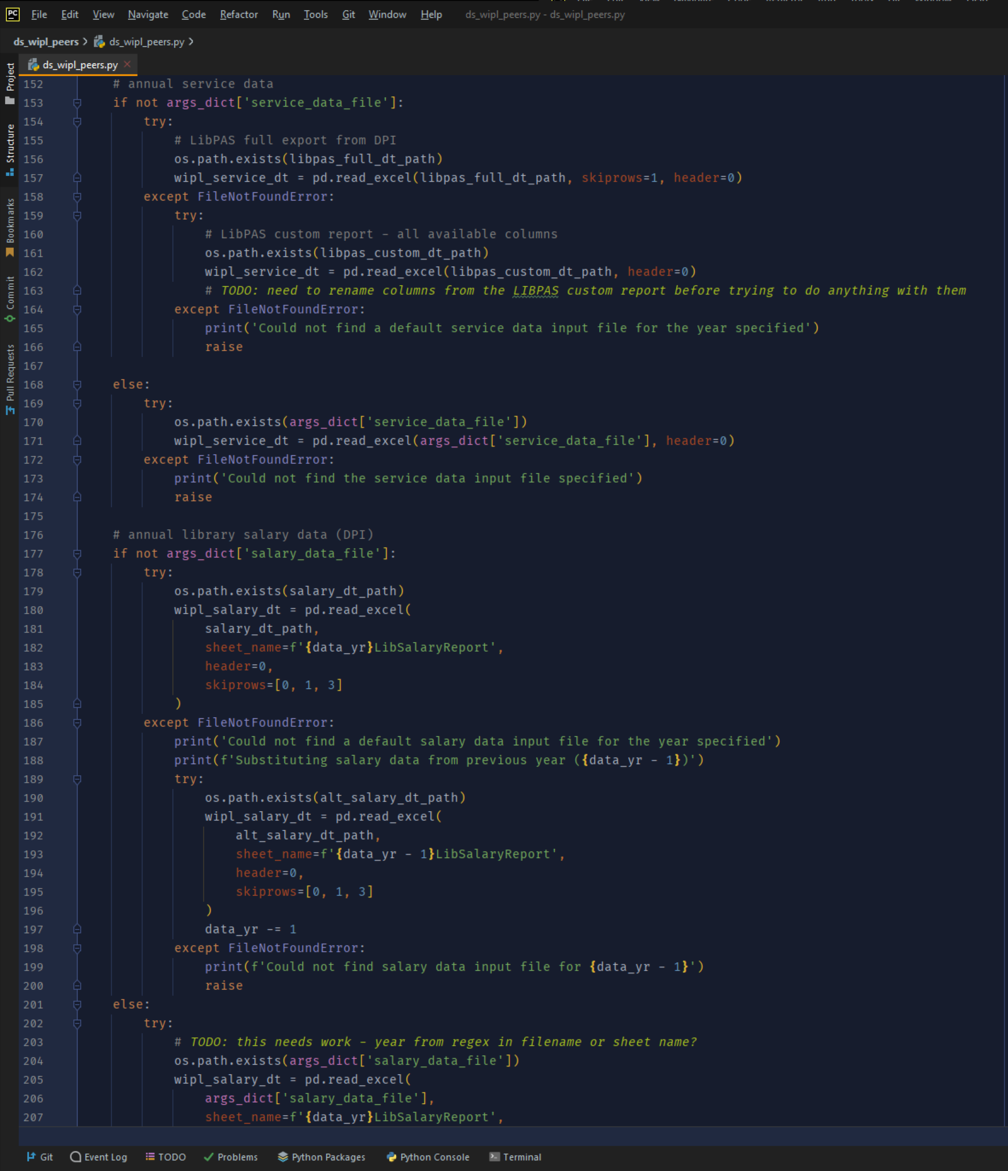
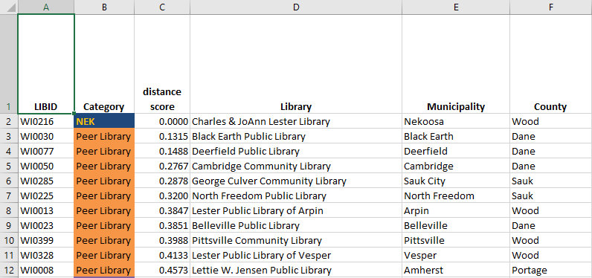

Slide 11
Challenge:
Make population projections for SCLS library communities to help with building design and planning.

Slide 12
R
Open-source programming language
Mathematical modeling, machine learning, forecasting
Data visualization
ggplot2

Slide 13
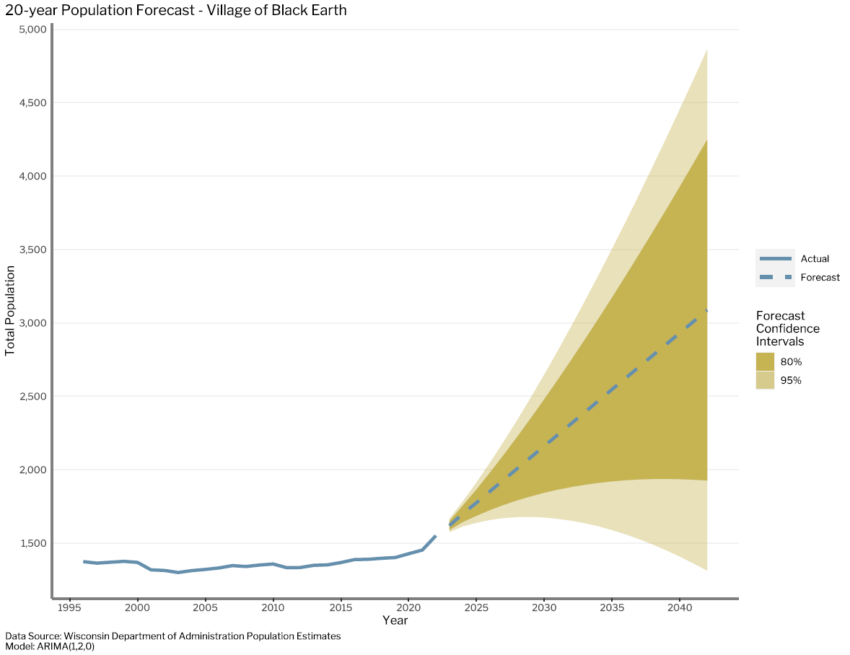

Slide 14
Challenges:
Collect and clean data quickly and in a reproducible manner without writing code.
Summarize and visualize large datasets in a user-friendly way.

Slide 15
Tableau
Tableau Prep:
Data collection, transformation, formatting, and output
Tableau Desktop:
Data visualization, data exploration
Build dashboards with sophisticated behaviors
Tableau Public:
Tableau-hosted webserver for dashboard publication

Slide 16
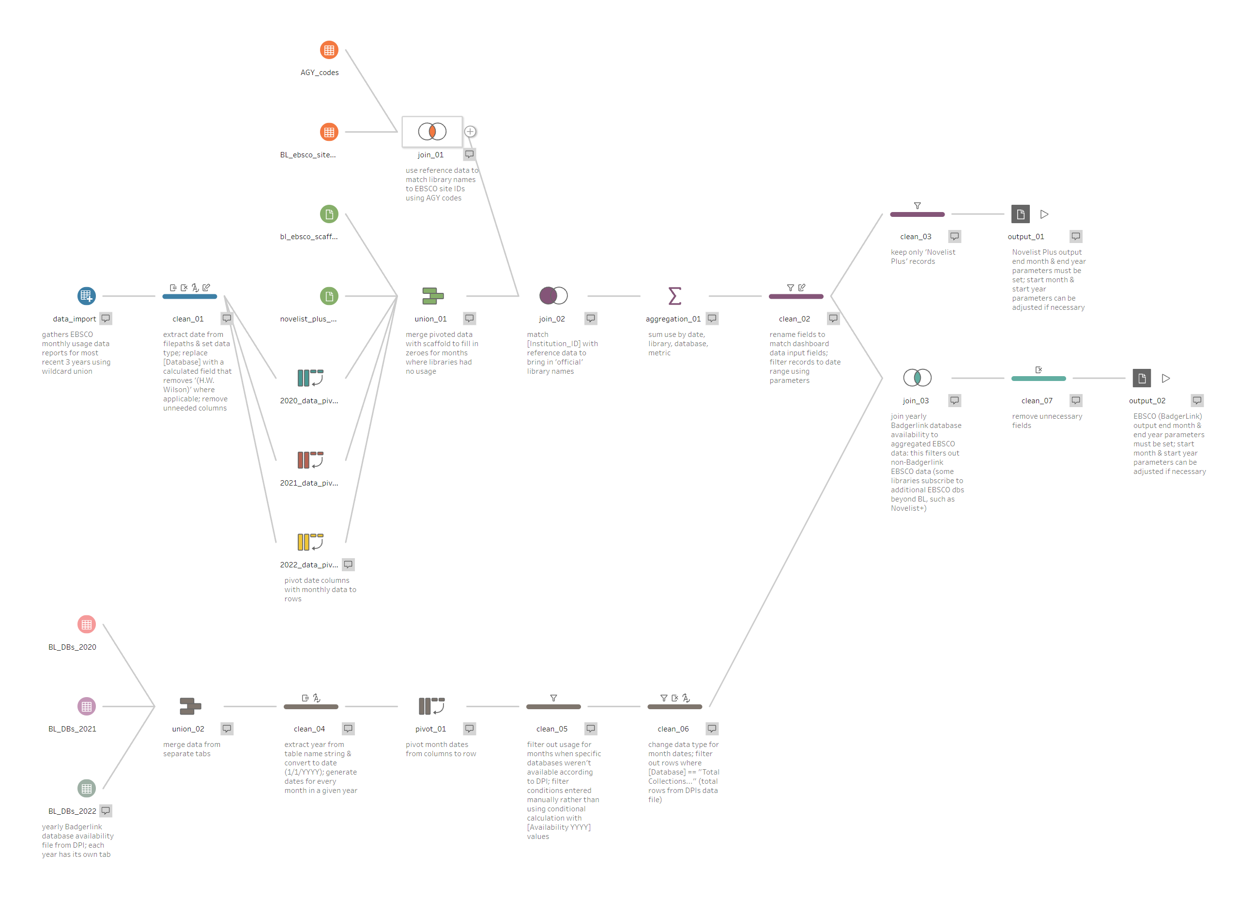

Slide 17
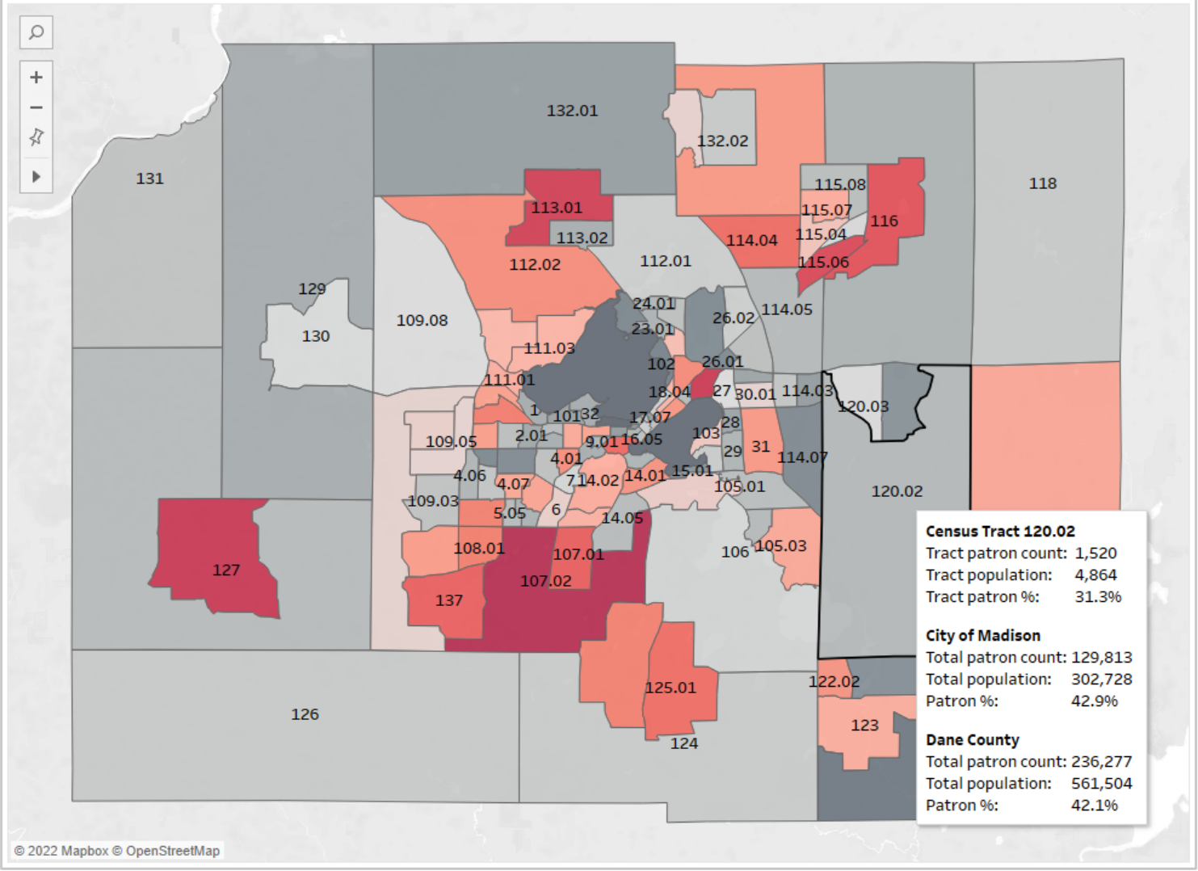

Slide 18
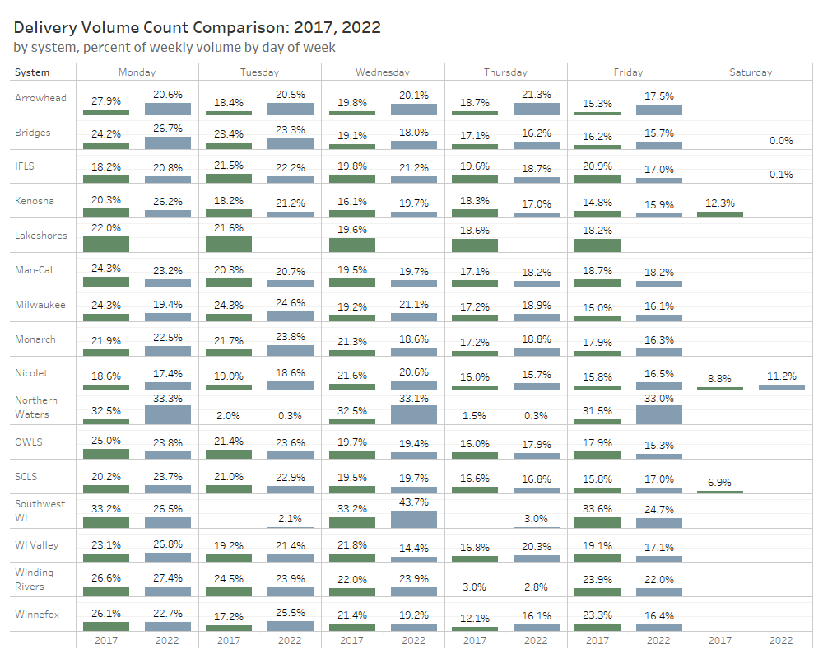

Slide 19
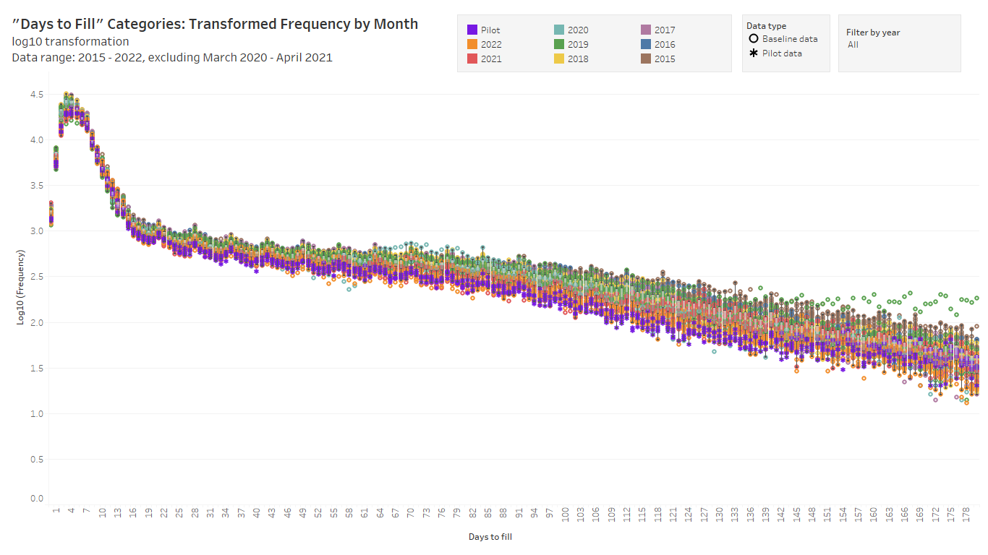

Slide 20
Thank you!
Tim Drexler
SCLS Data Services Consultant
tdrexler@scls.info, 608-246-7973

