Slide 1
Building needs assessment workgroup (BNAW)
Update March 2023

Slide 2
charge
The purpose of the Building Needs Assessment Work Group (BNAW) is to research and recommend to the SCLS Board of Trustees, SCLS staff and member libraries the most efficient and cost effective facility/facilities to best serve all departments and customers of the future SCLS organization.
BNAW will serve as a forum for discussion and decision–making concerning SCLS facilities including location, size, cost and function while realizing that authority for building and land purchases rests with the system board.

Slide 3
description
The Building Needs Assessment Work Group (BNAW) is composed of representatives of all SCLS departments and the SCLS Board of Trustees. BNAW will report out at all regularly scheduled Administrative Council and All Directors meetings. These meetings will provide input to BNAW from the SCLS member libraries.
Currently SCLS rents two facilities with leases that expire in 2023. It has been the goal of the BNAW to complete a recommendation that allows implementation of its facilities plan before the leases expire.

Slide 4
goals
Design a building that operationally meets our needs better.
Achieve savings.
Facilitate more team work and unite culture between administration and delivery.

Slide 5
Work to date: 2018
2018: Spent the end of the year outlining our goals, charge, budget, financing options and evaluating the SCLS building needs.
Utilizing meetings, focus groups and surveys, compiled a master list of building needs and wants. Must have, nice to have, pie in the sky list.

Slide 6
Work to date: 2019
2019: Spent the year selecting a builder. Through a process of inviting builders in to do presentations, followed up by a request for information, evaluated using a scored evaluation matrix, and followed up with site visits, selected the Design-Build firm Keller, Inc.
Keller is a Design-Build firm that will assist SCLS through all phases of design and construction, to include site selection and evaluation, budgeting and the public bidding process.
Keller primarily works with public projects and is able to work within the SCLS budget.

Slide 7
Work to date: 2020
2020: Worked with Keller to create a Discovery Booklet, created by having Discovery meetings with all staff and departments, to outline building needs/wants.
Keller created this booklet that outlines space needs, square footage and estimated budgets for the project.

Slide 8
Work to date: 2021
2021: Site Selection, Financing and Floor Plans
Worked with Keller and Lighthouse Realty on site selection. Criteria used in site selection included location (near major highway systems for Delivery), cost, on MUFN map, cellular service, on bus route, other services/amenities available in the area, walkable neighborhood.
The site selected that met all criteria at this time was at 2801 Walton Commons Lane in Madison. A purchase and sale agreement was been drafted and signed with the City of Madison, with the goal to close on the sale of the property by May 2022.
Secured financing for the project through the Board of Commissioners of Public Lands.
Spent the year drawing up floor plans and construction documents.

Slide 9
Work to date: 2022
2022: Public Bid, Budget Crisis, Start Over…
Finalized construction documents and held our public bid opening in May 2022.
Due to the effects of the pandemic, staffing shortages and cost increases for building materials, we did not receive bids for all units. Those we received, plus estimates for those we were missing, came in at $2 million over budget.
The Walton Commons project came to an abrupt halt.
So now what do we do?

Slide 10
THE NEW PLAN: 2022
Summer 2022: Pivot, Evaluate Options, New Building Plan:
BNAW pivoted quickly and worked with Keller to evaluate several alternative building options. We still have to move out May 31, 2023!
Revisited the option of buying and renovating an existing building. With the pandemic, and the shift toward companies offering remote working options, we found that the availability of existing office buildings had increased and the cost had decreased significantly in the past 2 years.
Selected the Lakeland University building at 1650 Pankratz Street, Madison. This location has highway access for Delivery, has adequate space and layout for HQ, space on the lot to add the Delivery operation, is on MUFN, on bus routes and is within budget. Made an offer allowing 90 days to complete due diligence on the site.
In September 2022, after satisfying all of the contingencies, the SCLS Board of Trustees voted to move forward with the purchase of the building. SCLS has a new home!

Slide 11
Our new home: 2023
September 2022 – Present: Re-Design, Public Bid, Begin Construction, Move In!
SCLS worked with Keller to re-draw our plans to remodel the existing building and design an addition to house the SCLS Delivery operation.
Many groups have worked together collaboratively to finalize the last details of the new building, which include moving the data center and the transformer, installing security, AV, VoIP, designing collaborative spaces, office space and interior design.
BNAW is also working with the Focus on Energy project to design an energy efficient building and qualify for rebates.
Public bid was held March 2, 2023. This one was successful!
Bid package and final building project budget to be submitted for approval at the March 23, 2023 SCLS Board meeting.
April 1st: Break Ground!

Slide 12
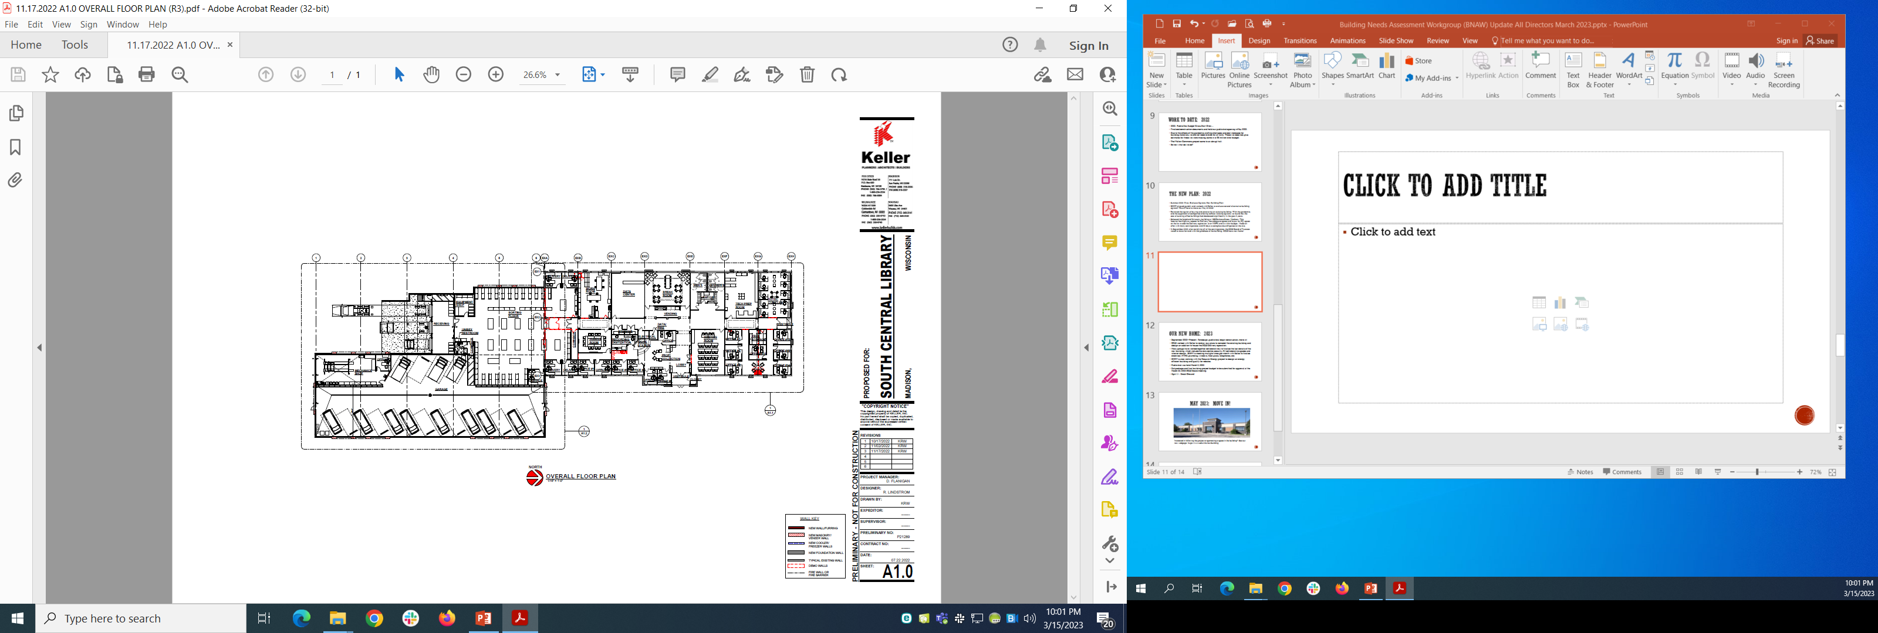
final floor plans: 2023

Slide 13
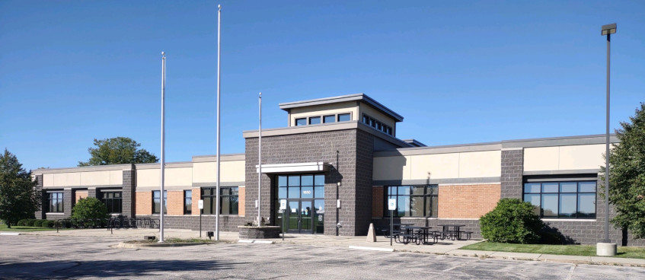
May 2023: move in!
Interested in following the project or sponsoring a space in the building? See our new webpage: https://www.scls.info/new-building

Slide 14
Budget considerations: administration
TOP 3 BUDGETARY FACTORS MOVING INTO 2024-2025
System State Aid
  Increase in state budget?
  Effect on SCLS
PLSR
  Delivery hub implementation
  Delivery grants
  Impact on SCLS Delivery operations and budget
New Building Budget and Timeline
  Impact of pandemic on building supply chain and cost of materials
  Any unforeseen issues during construction

