Slide 1
SCLS FINANCIAL STATEMENT REVIEW
October 2023

Slide 2
South Central Library System
Financial Statements Review
These reports are issued every month as part of the Board of Trustees information packet
Cash Activity
Cash Activity Pre-paids
Budget vs. Actual Income & Expense
Profit & Loss (for the month)
Balance Sheet

Slide 3
Cash Activity
This report provides a list of all bill payments (checks) to be approved at this month’s board meeting.
Checks are dated for the board meeting date.
Total Checking and Savings Amount (last page) is the total dollar amount of the checks written this month.
Total Checking and Savings Balance is the checking account balance after the checks have been written.
Bill reviewer will use this report to review bills for approval. Match each A/P form and amount to the corresponding item on the Cash Activity Report. Also review documentation attached to each A/P form.

Slide 4
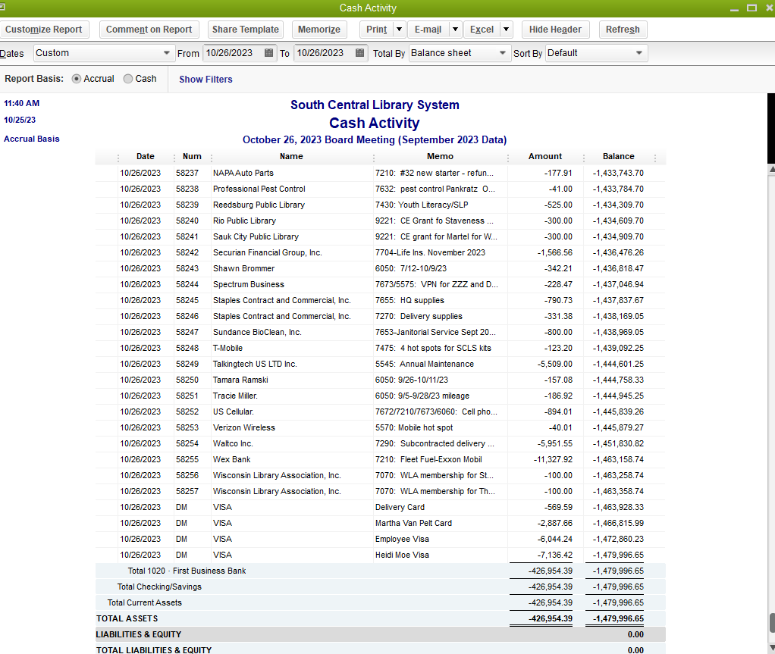

Slide 5
Cash Activity Pre-Paids
This report shows all activity in the checking account between board meetings.
Includes deposits, transfers, ACH debits, contractual payments, use of member libraries’ funds, bills due before board meeting.

Slide 6
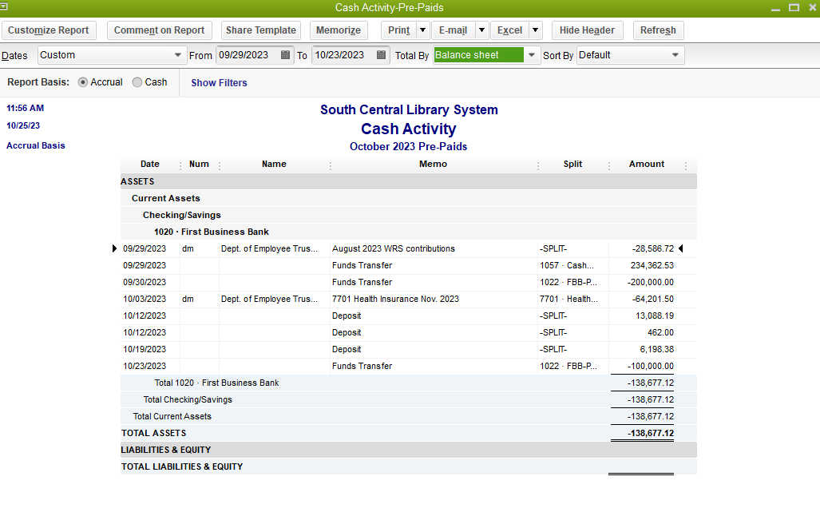

Slide 7
Budget vs. Actual Income & Expense
This report shows our year-to-date income received and expenses incurred through the last month ending.
Columns show:
actual income/expenses YTD
budgeted income/expenses for the entire year
$ over/under budget
% of budget used YTD
Carryover Income is listed in the budget however it is not “received” during the year. These are unexpended funds from prior years that are available for use during the current year. Carryover income accounts include:
General Carryover (4050)
Technology Carryover for Equipment Replacement (4245)
ILS Carryover for Future Development (4270)
Carryover Expenses are also listed in the budget. Typically the amount of carryover funds used during the year is minimal. Carryover expense accounts include:
Delivery/General Contingency (8010)
Technology Contingency (5585)
ILS Carryover for Future Development (5590)
Monitor % of budget used YTD to ensure we are on target with budget vs. actual

Slide 8
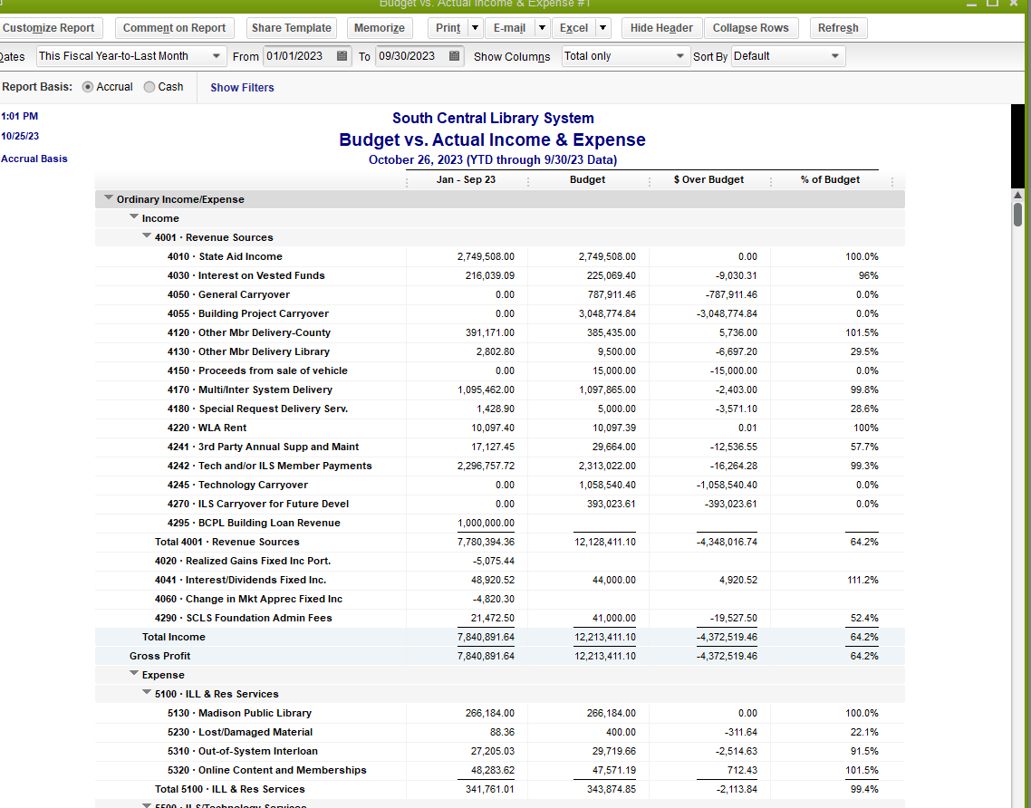

Slide 9
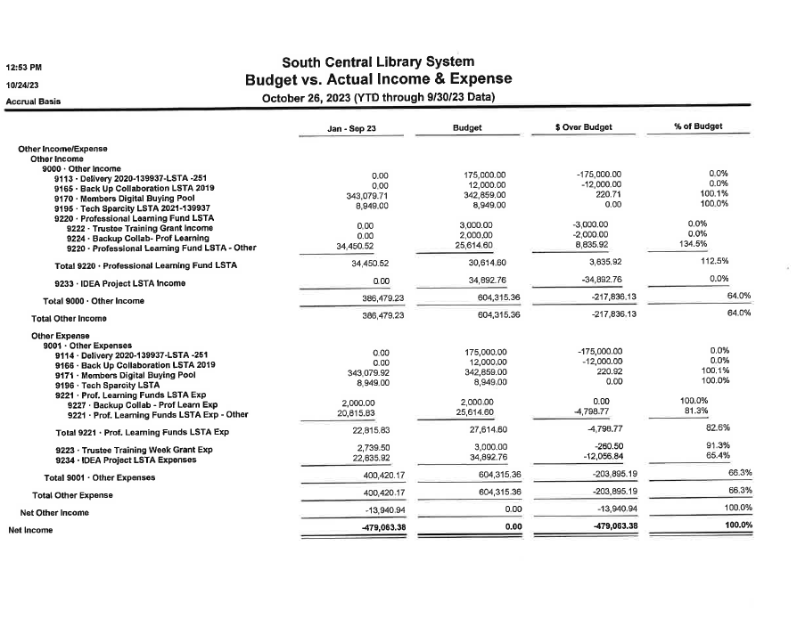

Slide 10
Profit & Loss (for the month)
This report shows income received and expenses incurred for the month in review.
Most income is received in January, while expenses are incurred throughout the year.

Slide 11
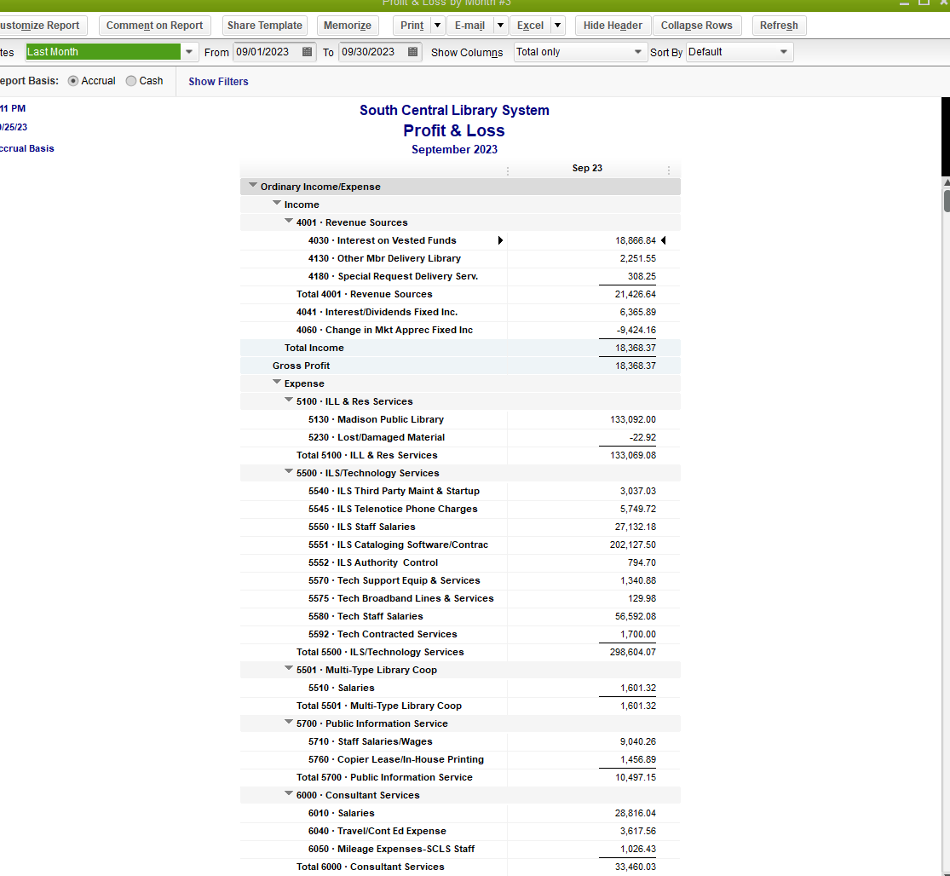

Slide 12
Balance Sheet
This report lists a year-to-date snapshot of our assets, liabilities and equity.
Assets: includes bank account balances, money due to SCLS by member libraries (Accounts Receivable) or Grants Receivable, any pre-paid expenses, and SCLS portfolio balances.
Liabilities: includes bills due (Accounts Payable), deferred revenue, retirement contributions due to Wisconsin Retirement System, accrued wages, accrued vacation time due to employees, member holding account funds, e-commerce funds due to libraries, the multi-type fund, and any e-rate rebate funds received for libraries.
Equity: shows the carryover funds available as of the last year-end.

Slide 13
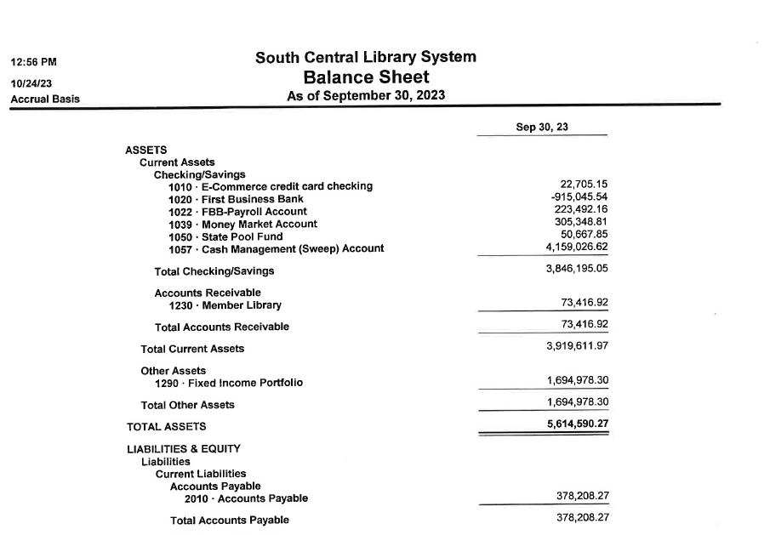

Slide 14
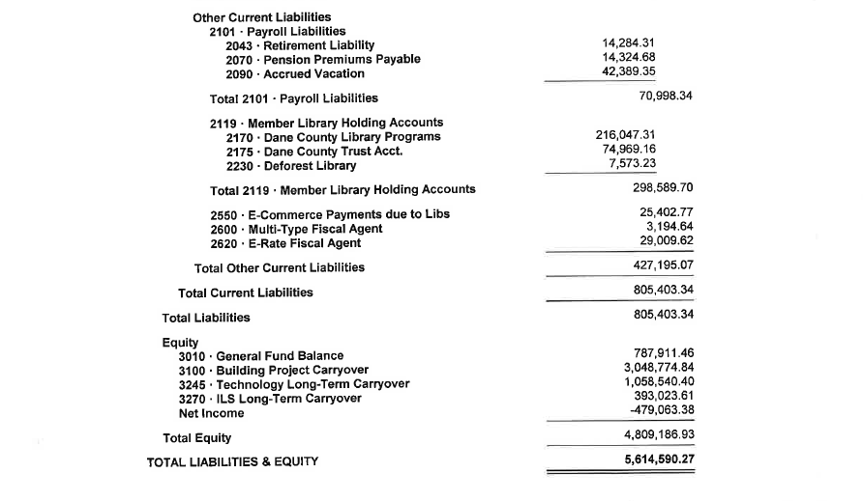

Slide 15
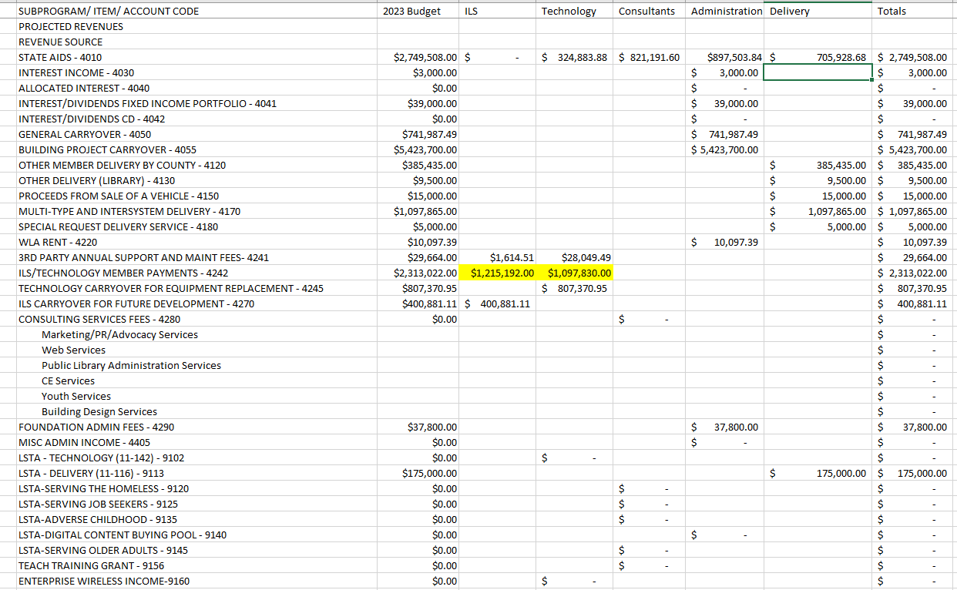
2023 Budget by Department and Allocation of State Aid

